Slide 1

Rise! Take Your Mat and Walk
World Day of Prayer 2020
Written by the women of WDP Zimbabwe
Based on John 5:2-9a

Slide 2
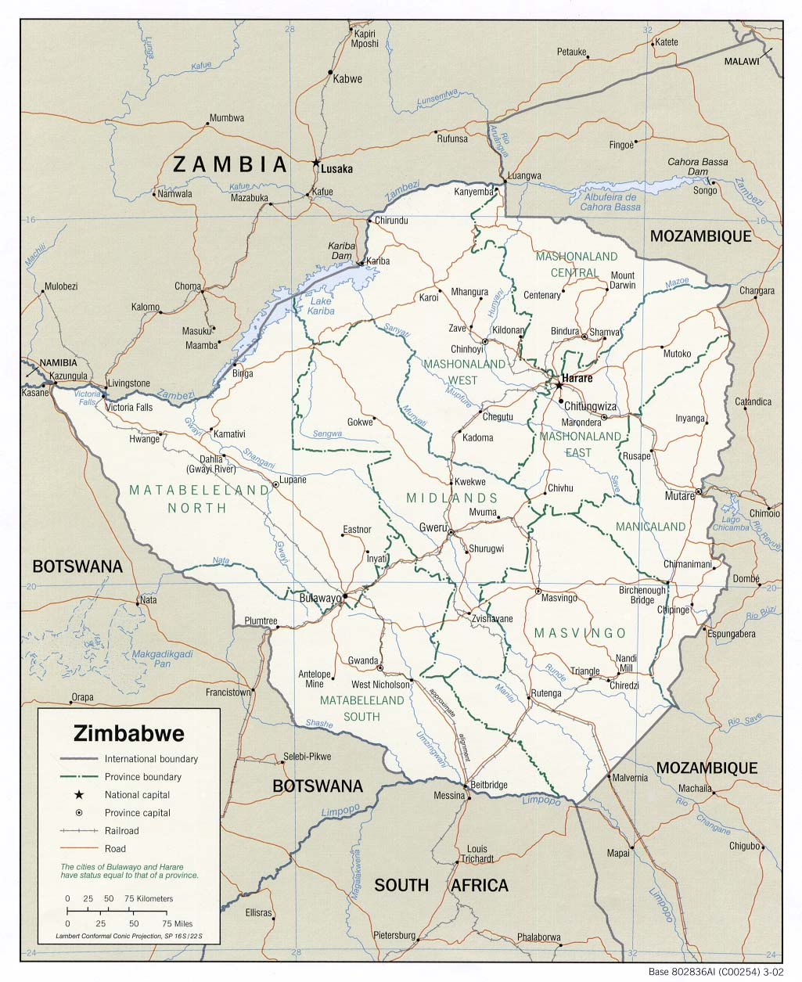
Geography & Population

Slide 3
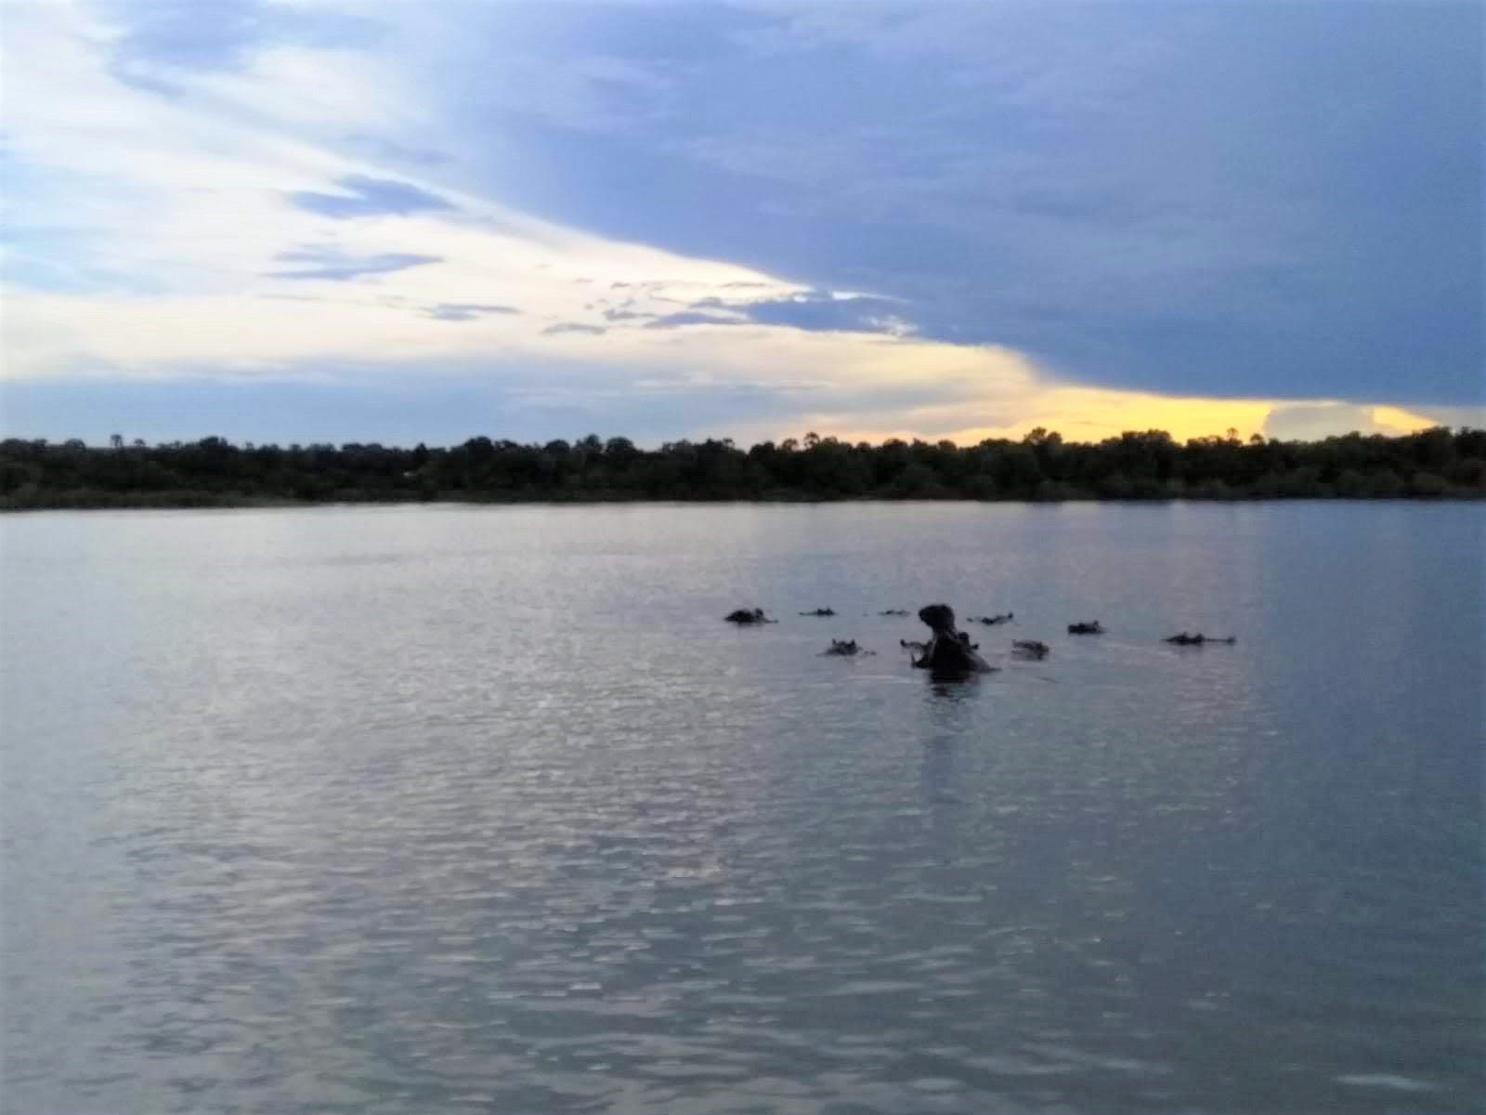
Zambezi River
©Julie Caddick

Slide 4
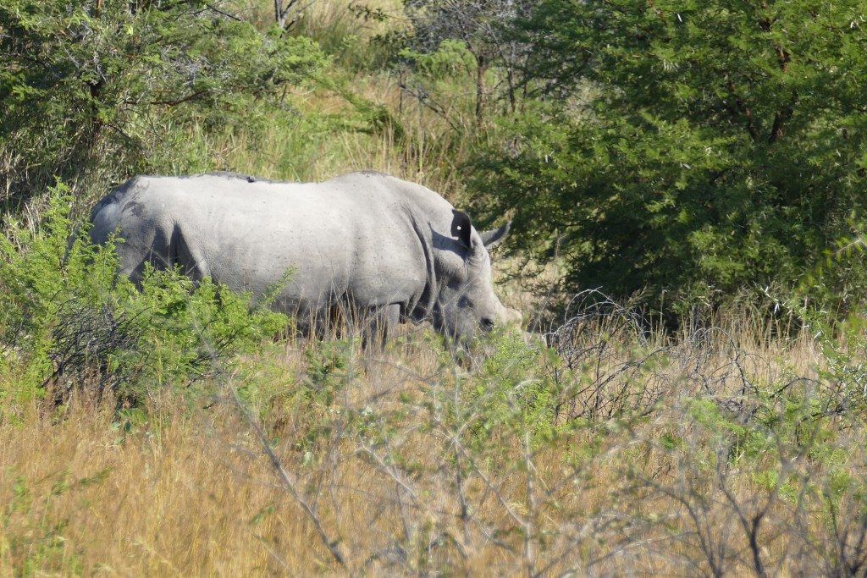
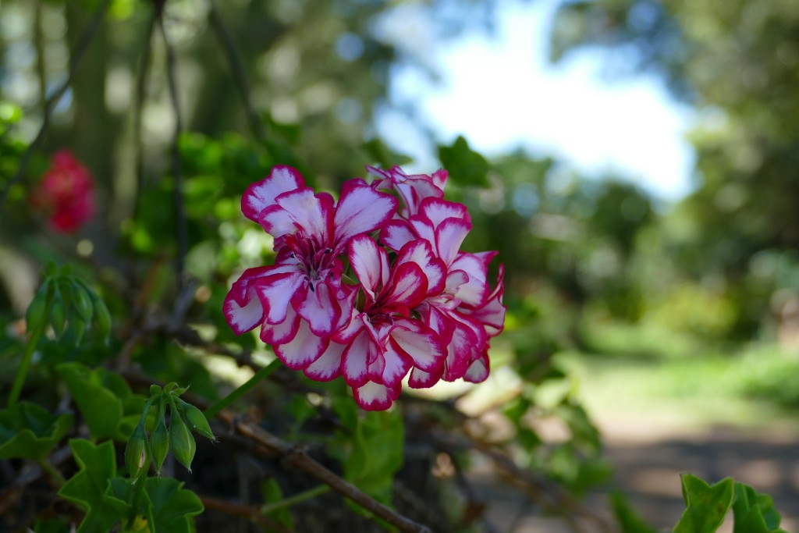
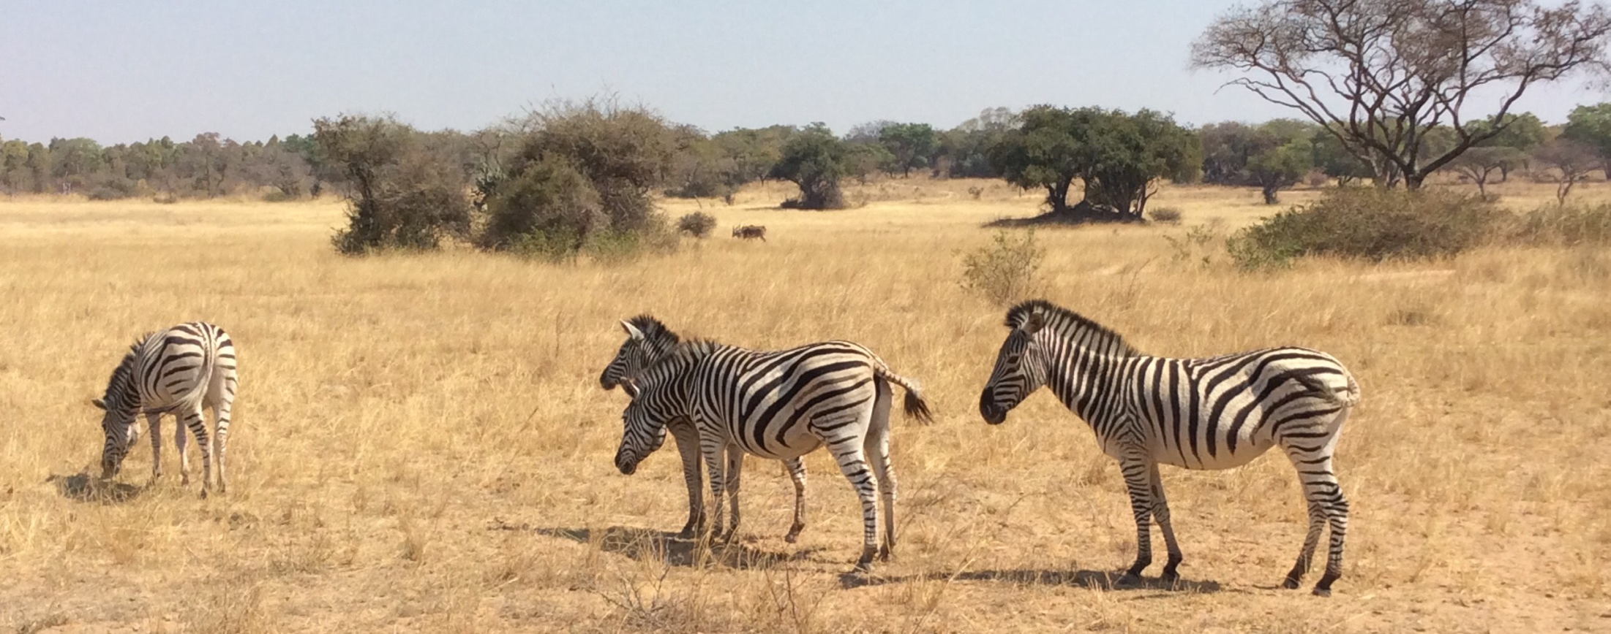
©wgt-ev
©wgt-ev
©WDPIC

Slide 5
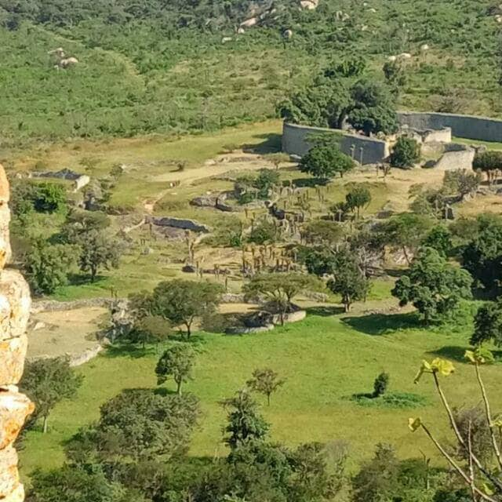
Great Zimbabwe Monument
©Ilkeny C Mzwanza

Slide 6
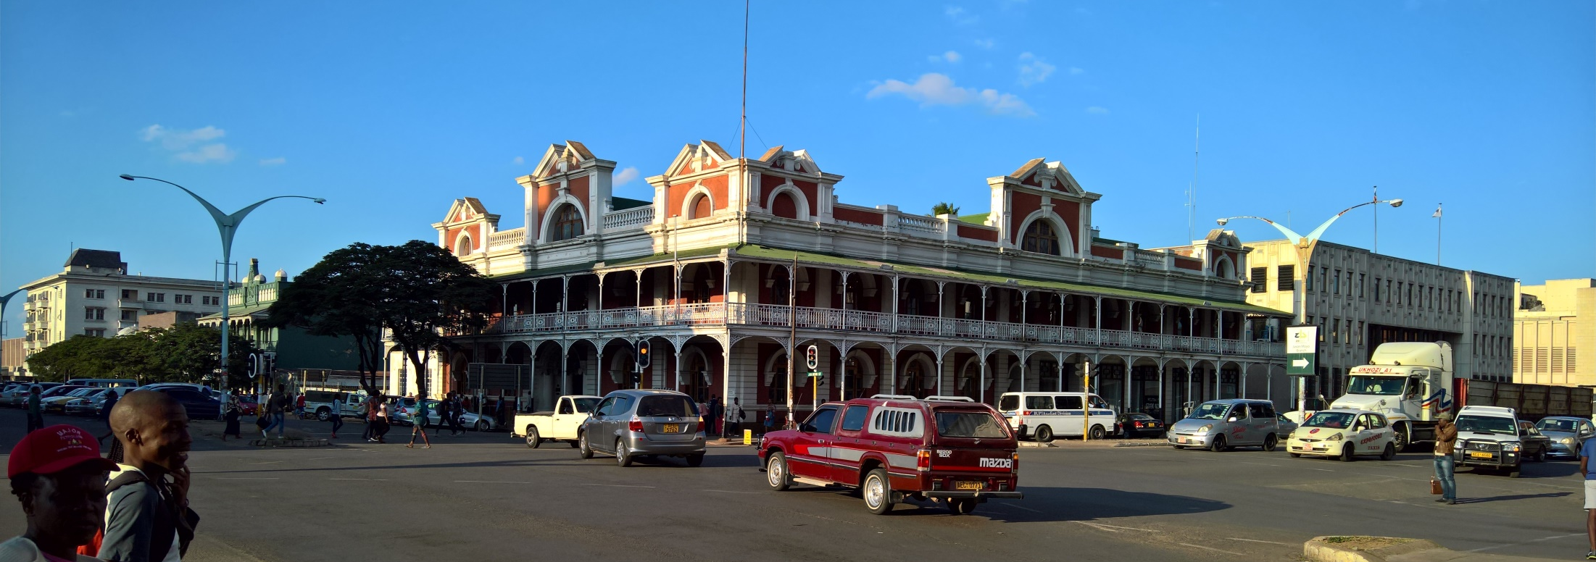
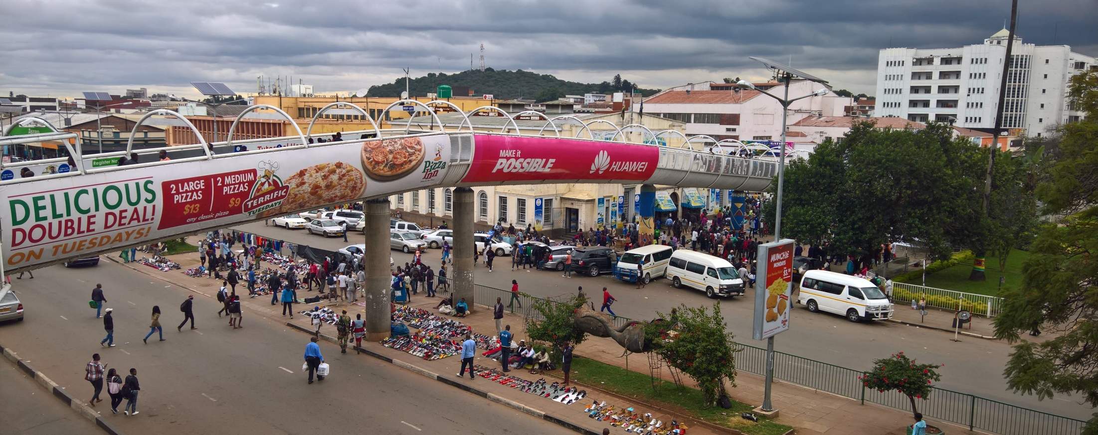
Bulawayo
©wgt-ev
Harare
©wgt-ev

Slide 7
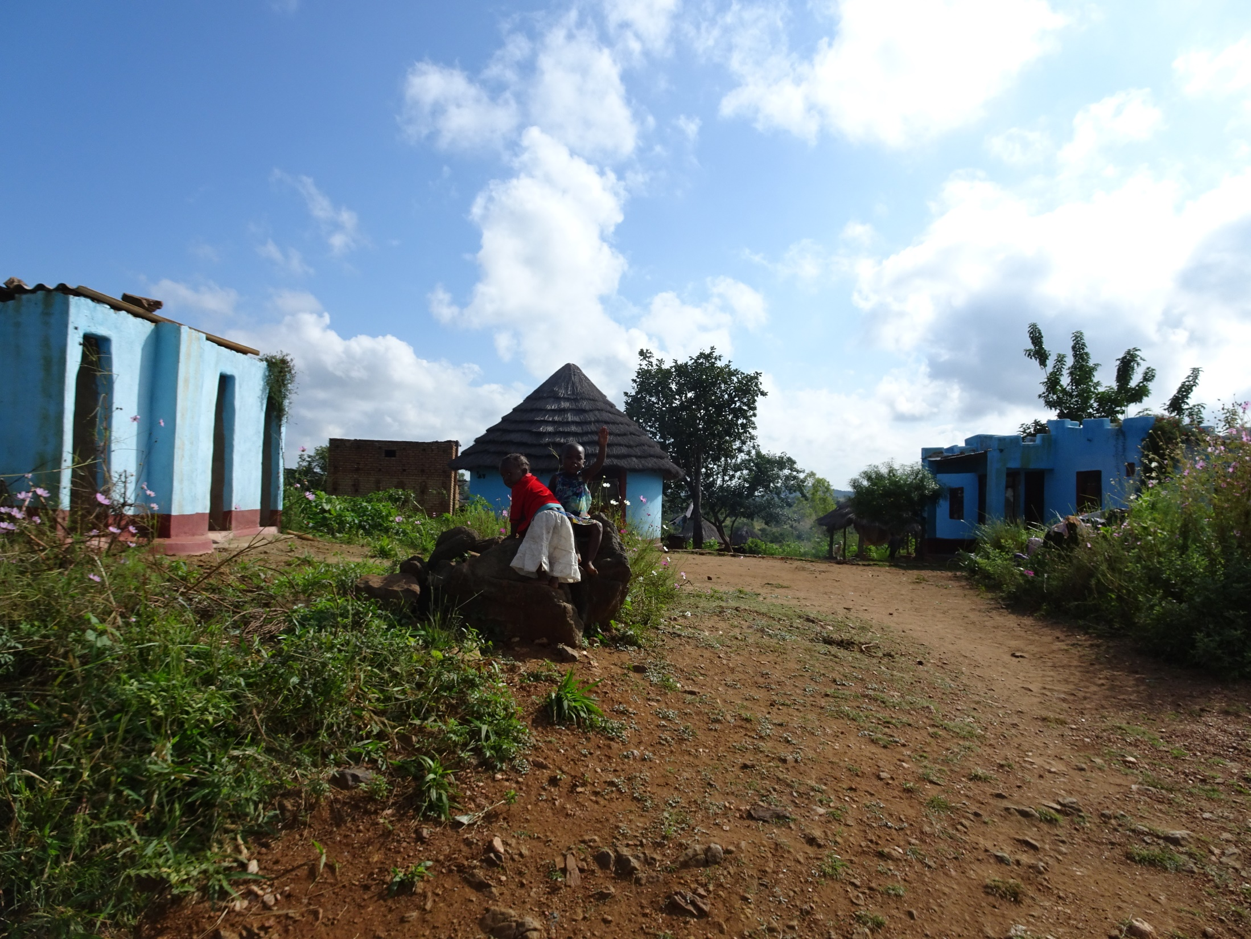
Village in Hurungwe District
©wgt-ev

Slide 8
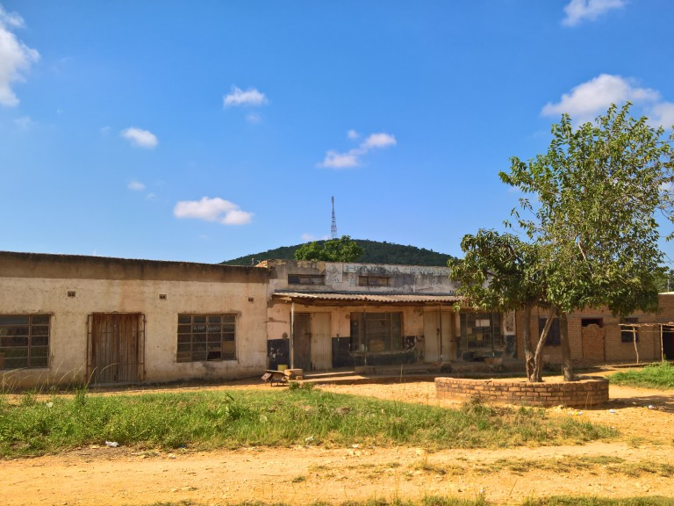
Village in Hurungwe District
©wgt-ev

Slide 9
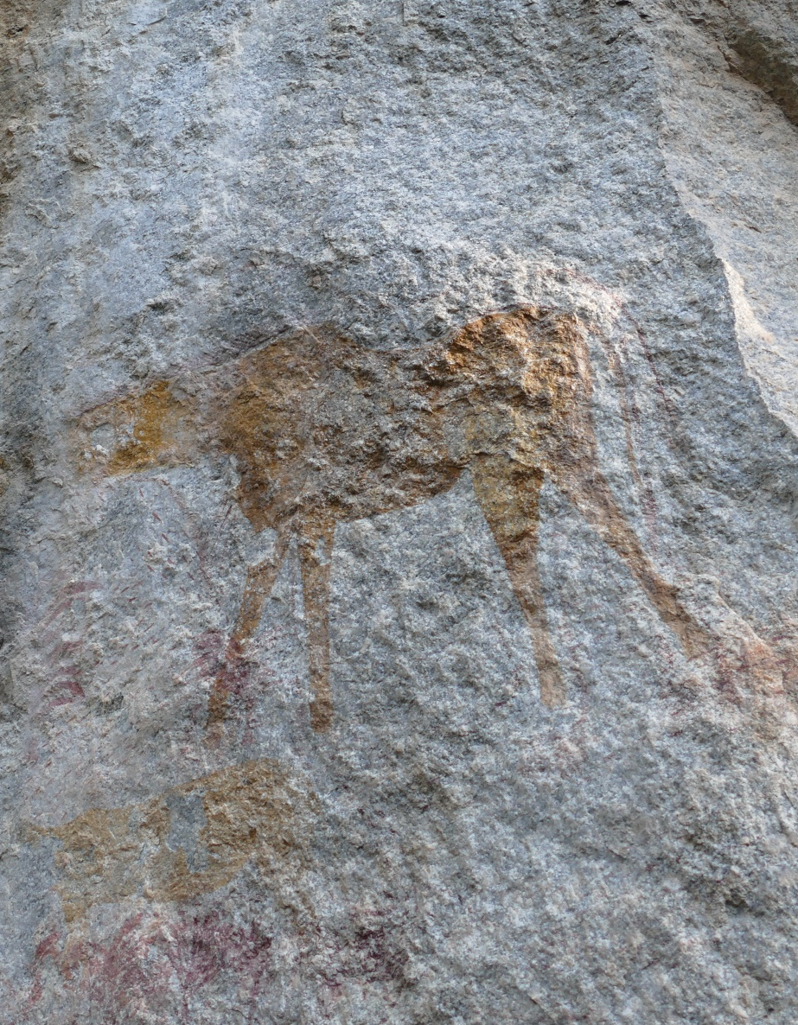
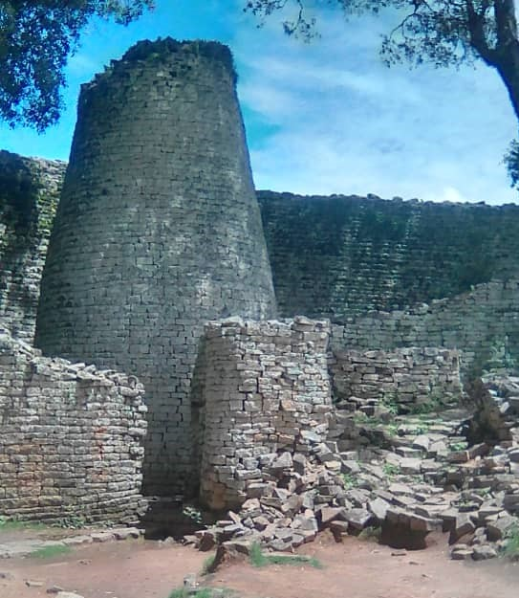
Political History
©wgt-ev
©Ilkeny C Mzwanza
Over 2,000 year old rock painting at Matobo Hills
Great Zimbabwe Monument

Slide 10
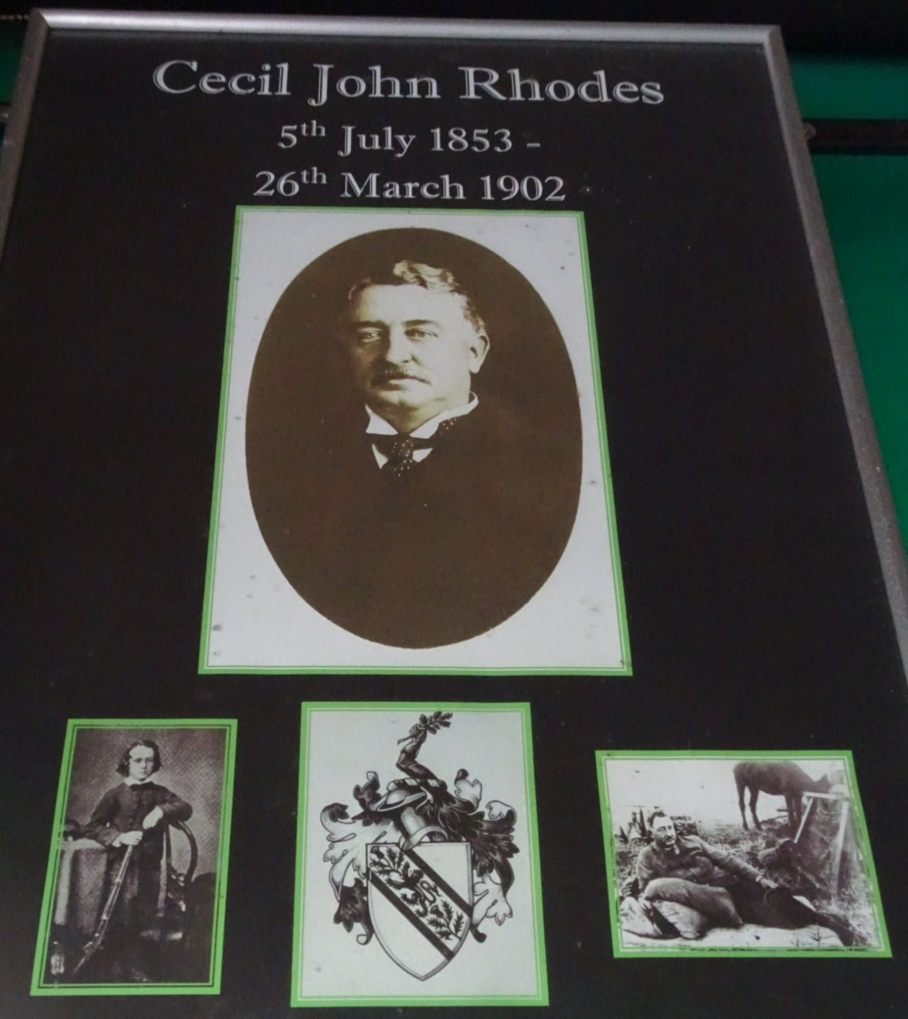
©wgt-ev

Slide 11
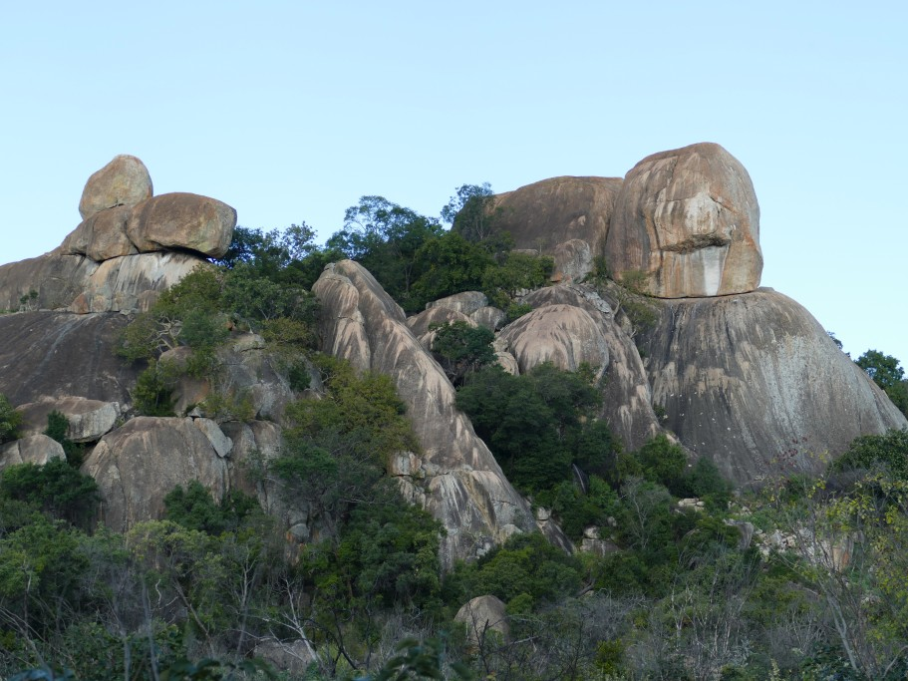
Matobo Hills - Site of the First Chimurenga
©wgt-ev

Slide 12
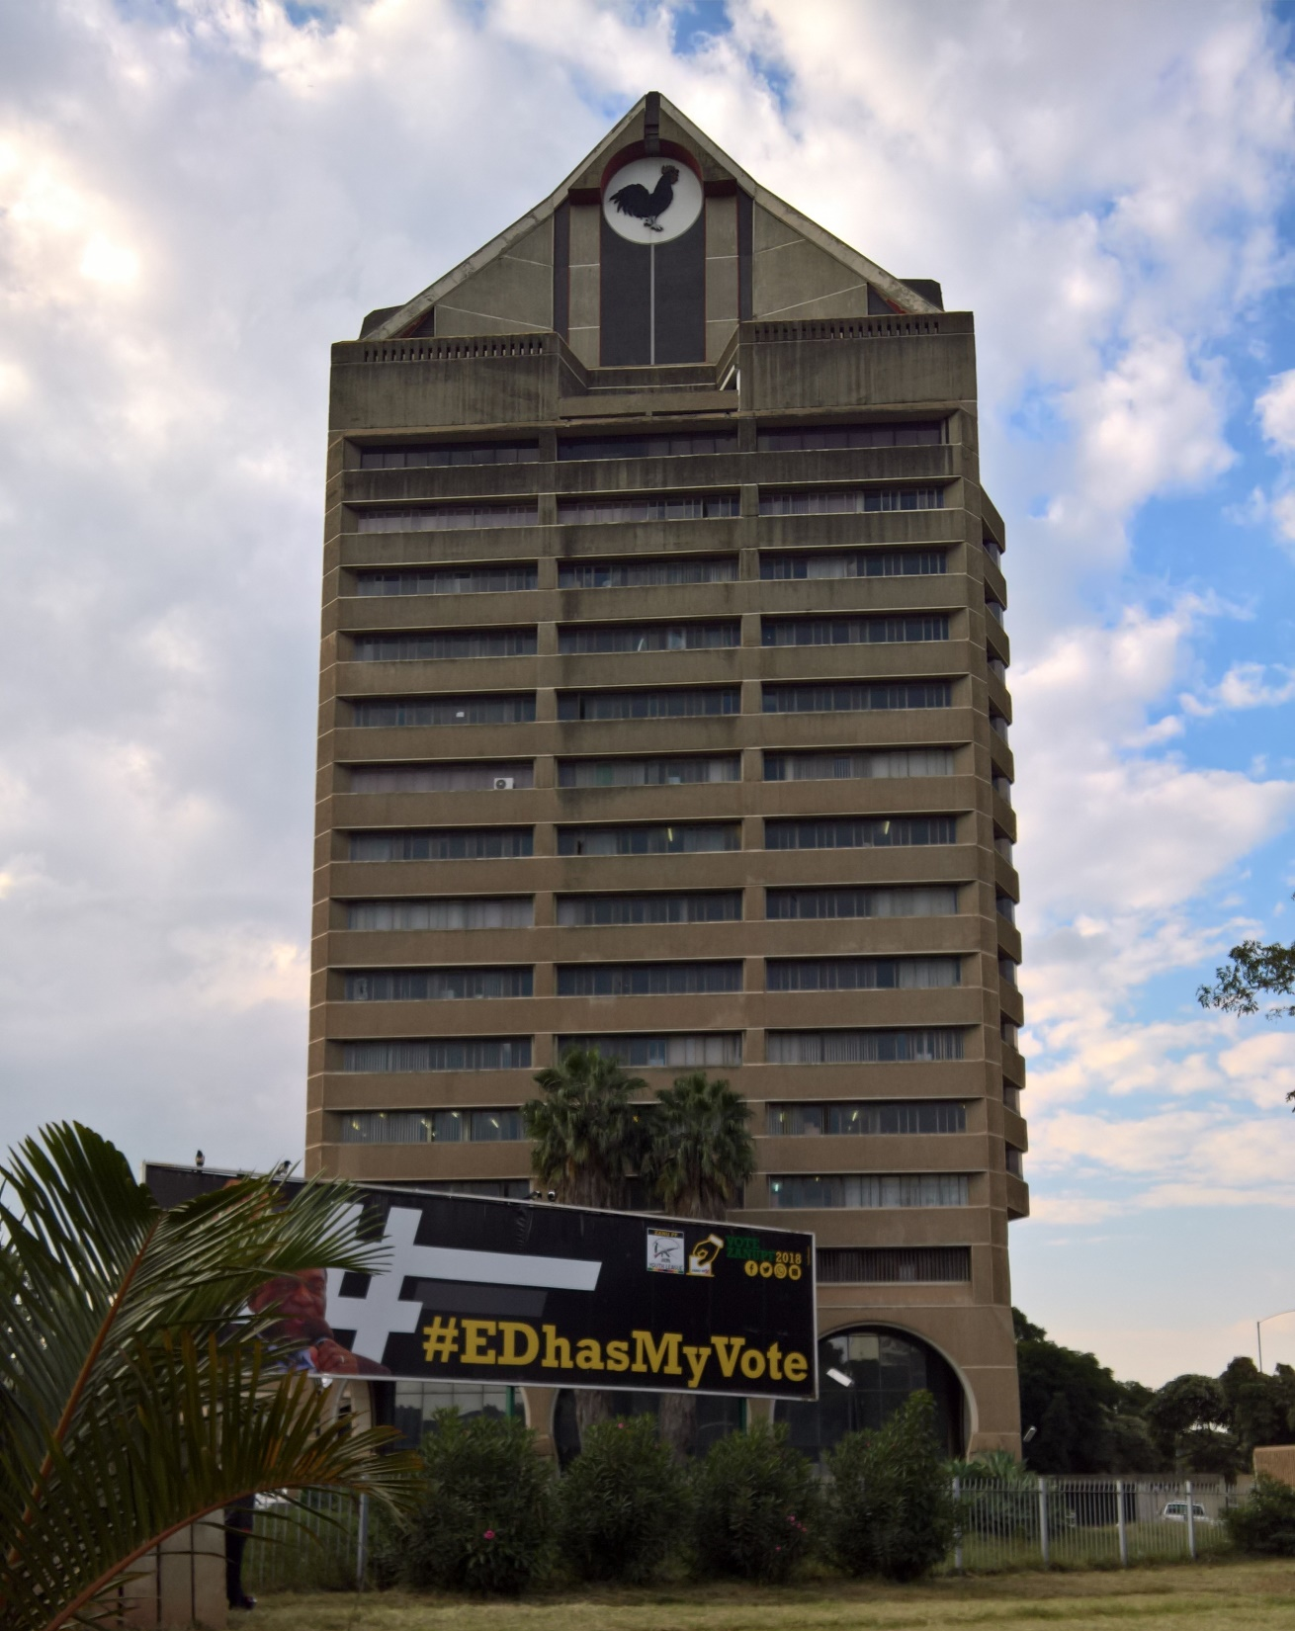
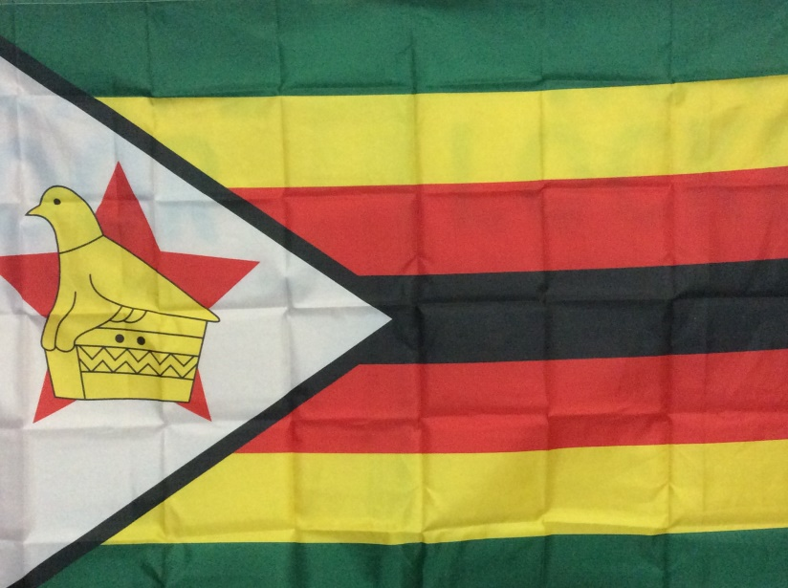
ZANU-PF Headquarter
©wgt-ev
Current flag of the
Republic of Zimbabwe
© WDPIC

Slide 13
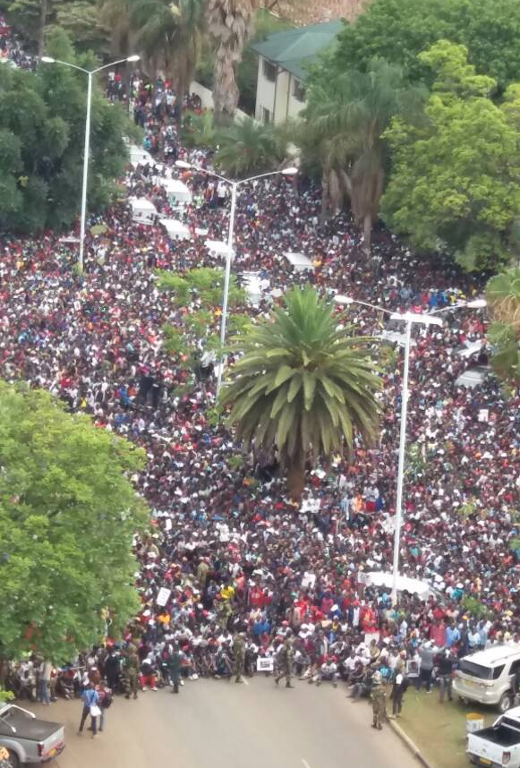
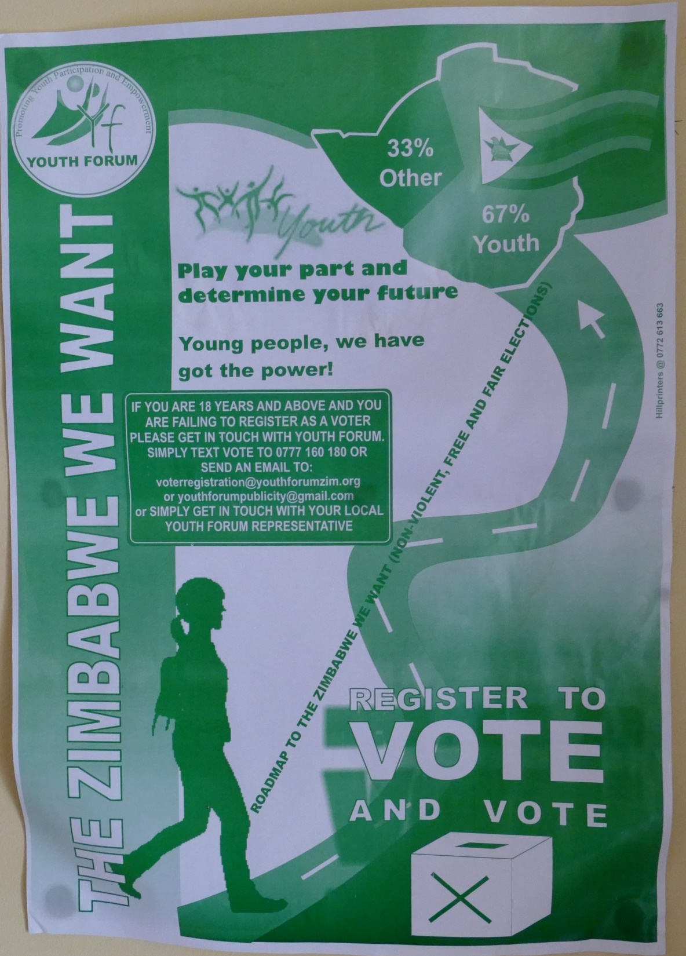
©wgt-ev
Street Protests ©Sikhangele Marowa

Slide 14
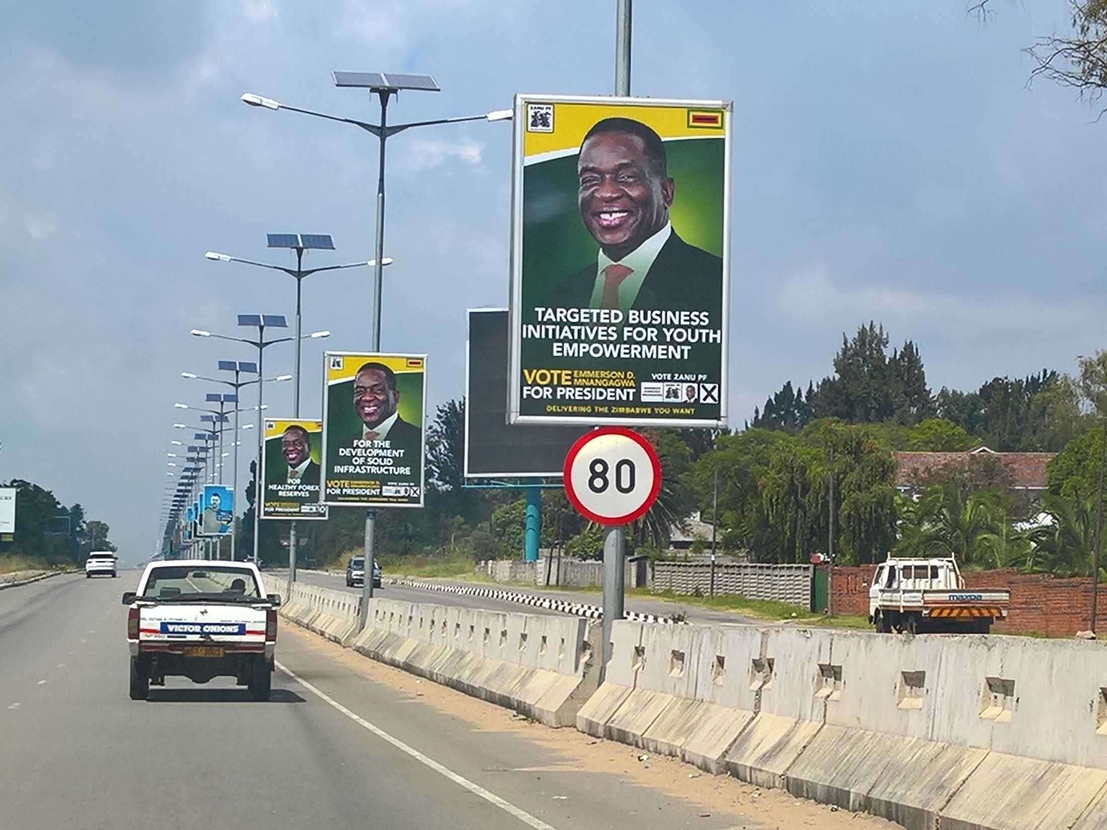
National Election Campaign
©wgt-ev

Slide 15
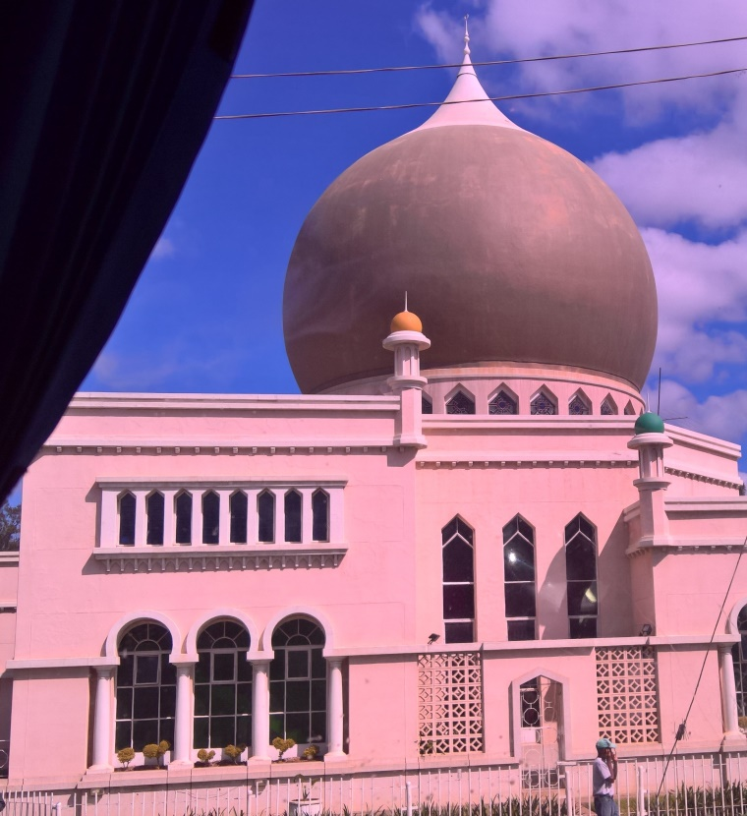
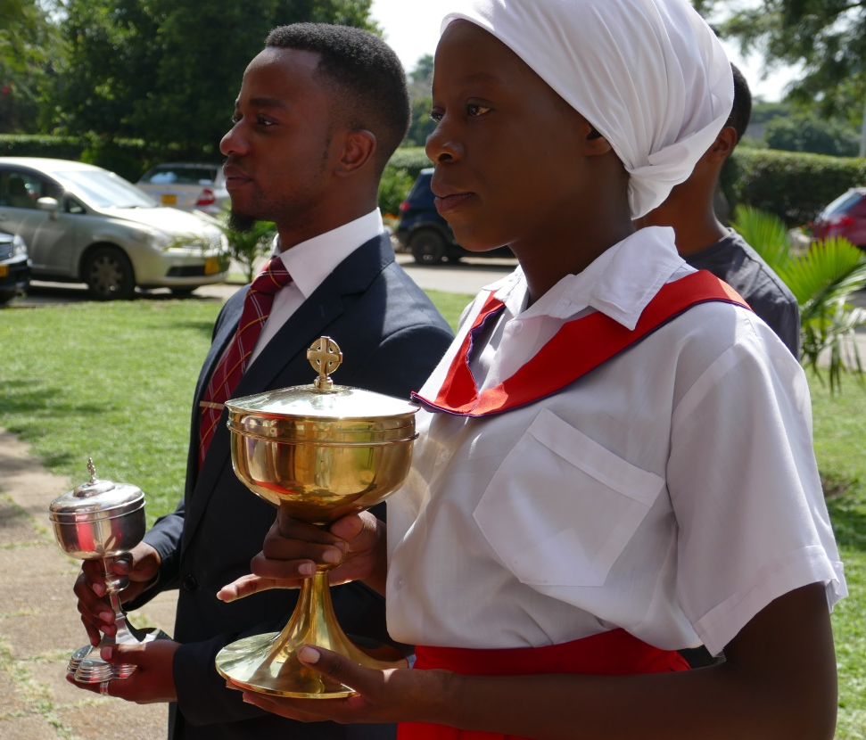
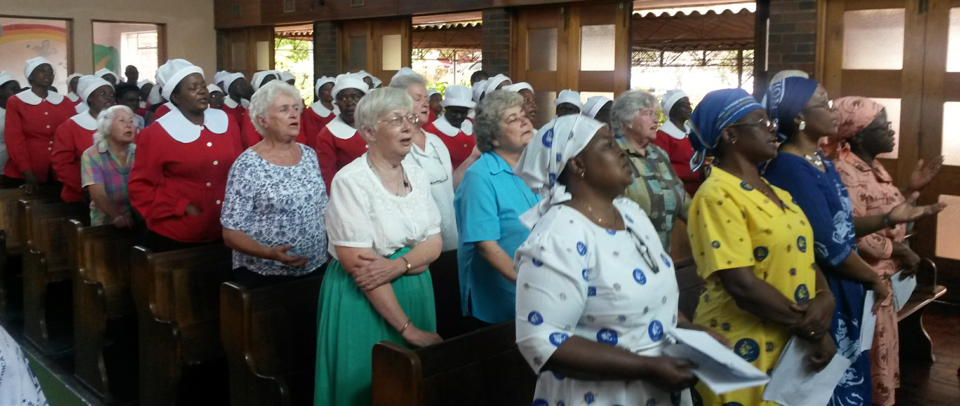
Religion
Mosque
©wgt-ev
Catholic Church ©wgt-ev
Methodist Church
©Julie Caddick

Slide 16
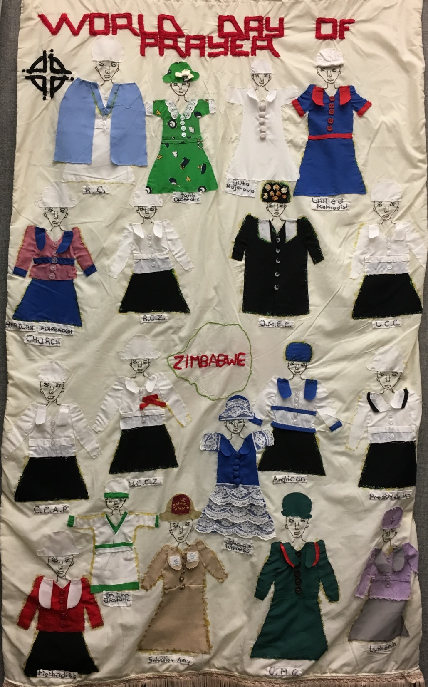
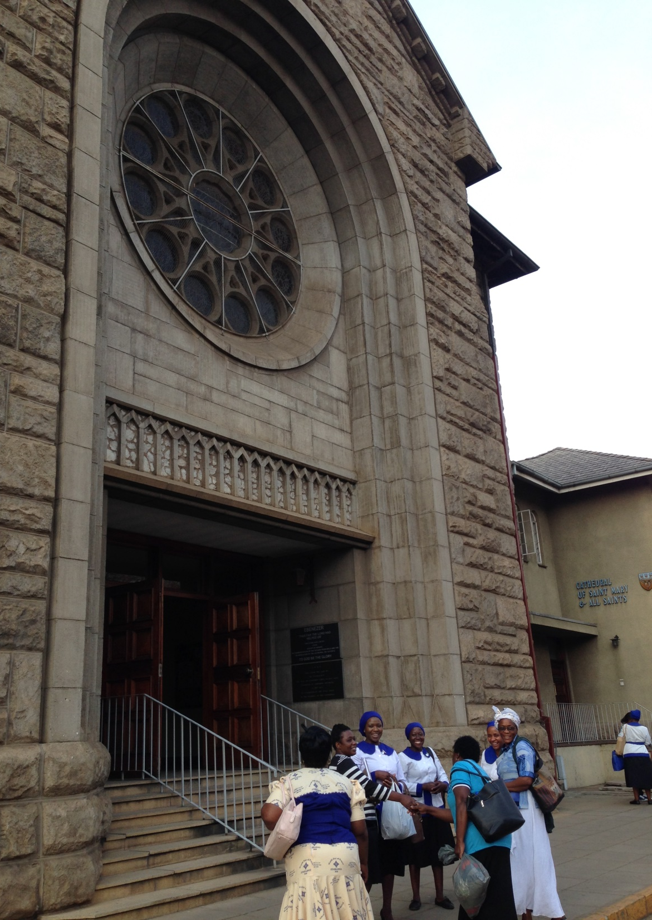
Anglican Church
©WDPIC
Denominational Uniforms
©WDPIC

Slide 17
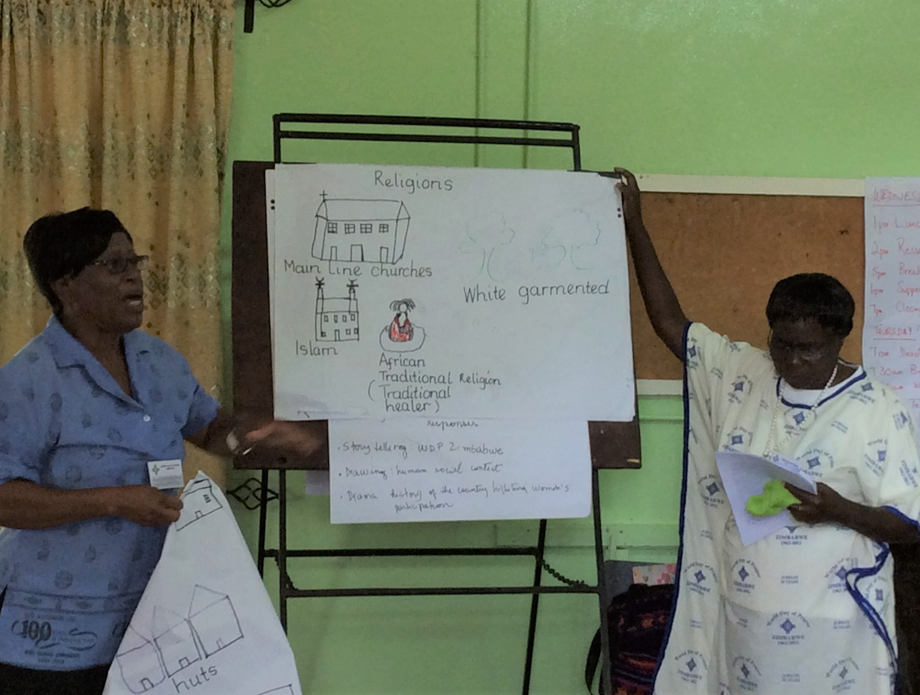
©WDPIC

Slide 18
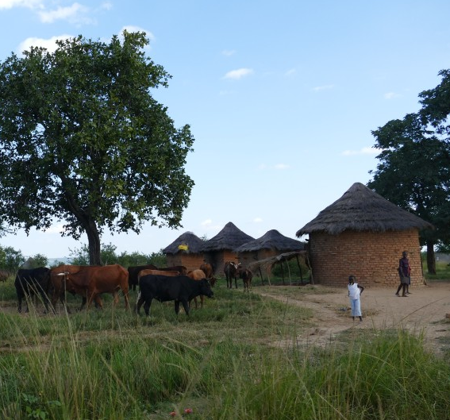
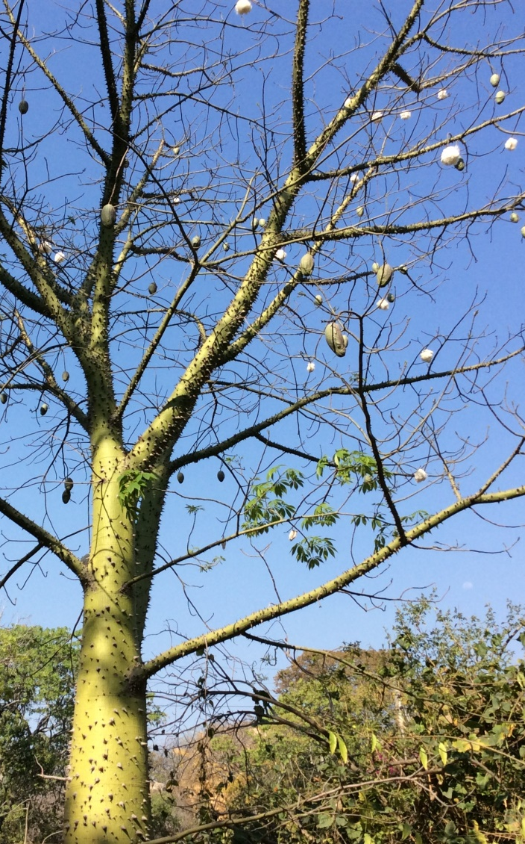
Economy
©wgt-ev
©WDPIC
Raising Cattle
Cotton Tree

Slide 19
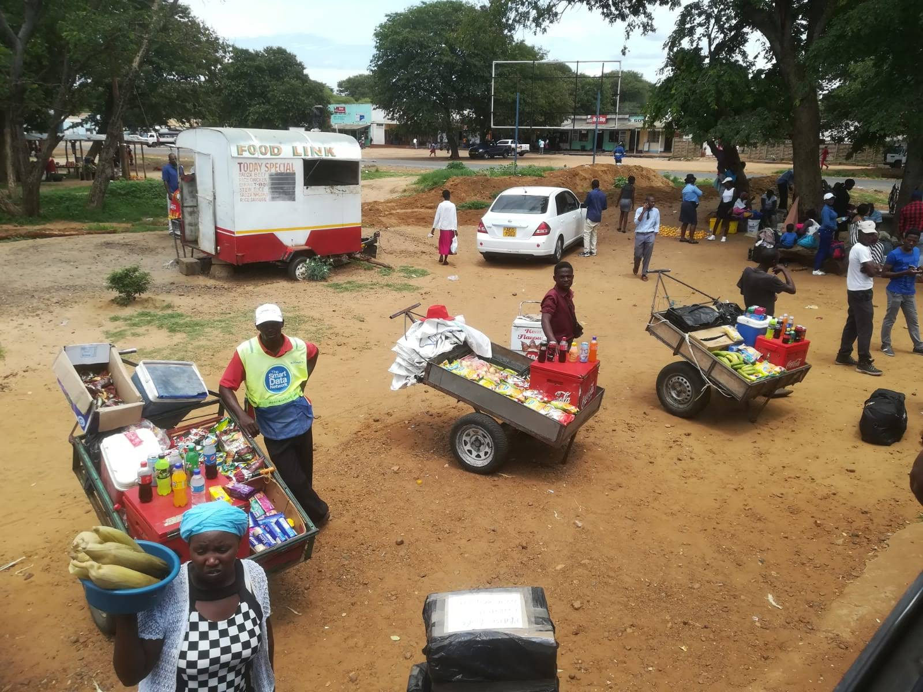
Street Vendors
©Julie Caddick

Slide 20
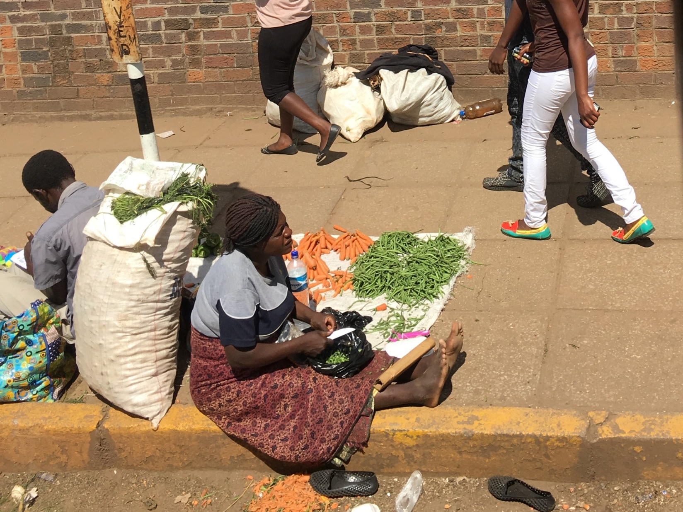
©WDPIC

Slide 21
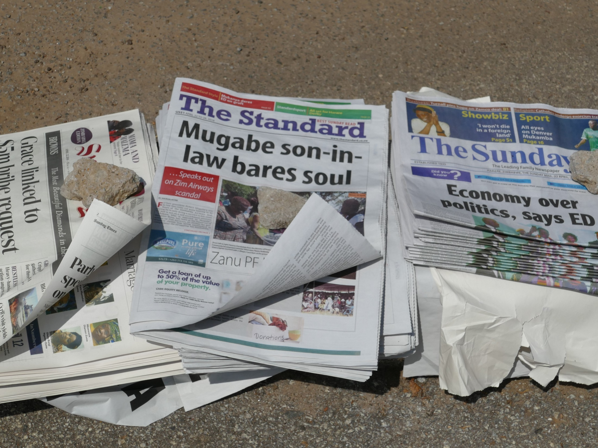
©wgt-ev

Slide 22
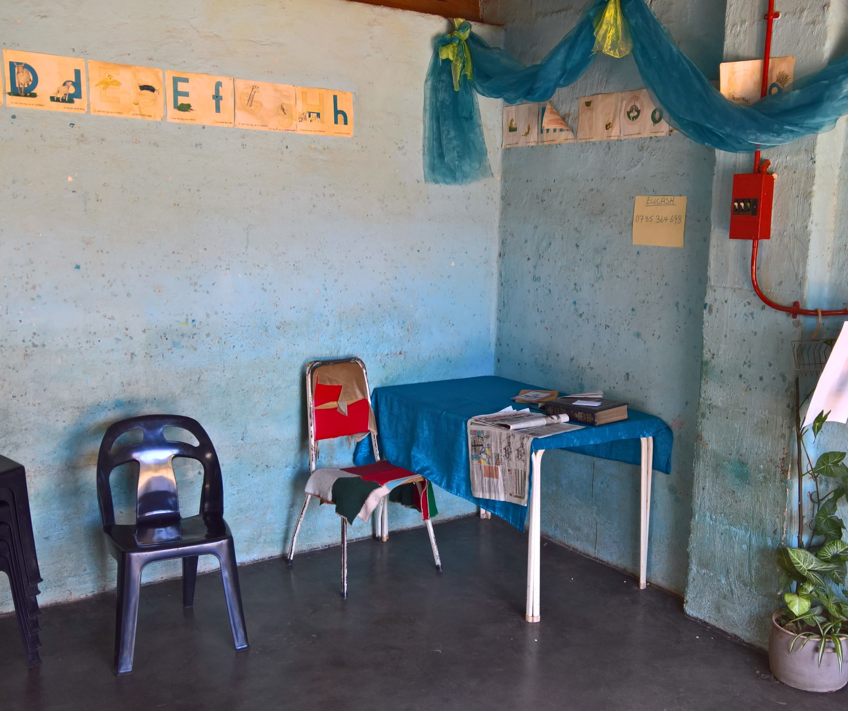
Education
©wgt-ev

Slide 23
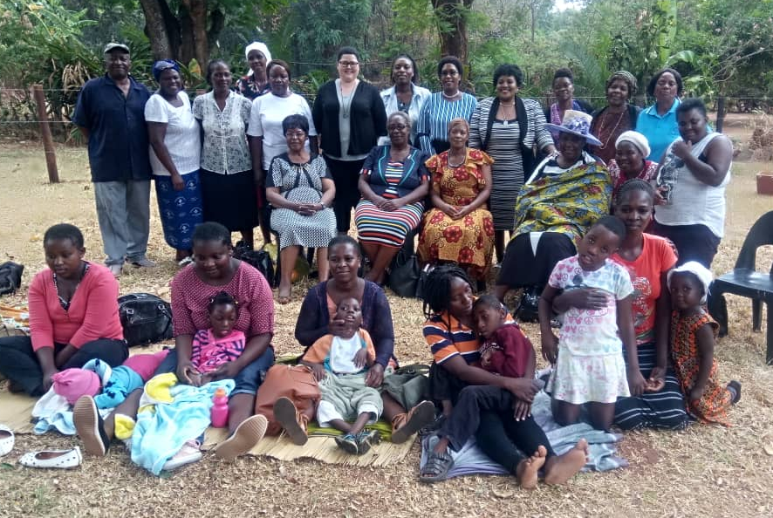
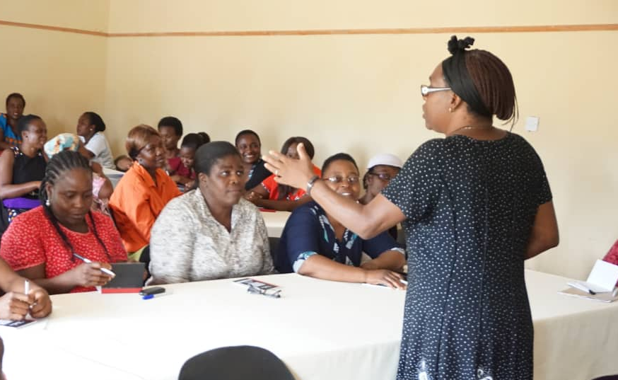
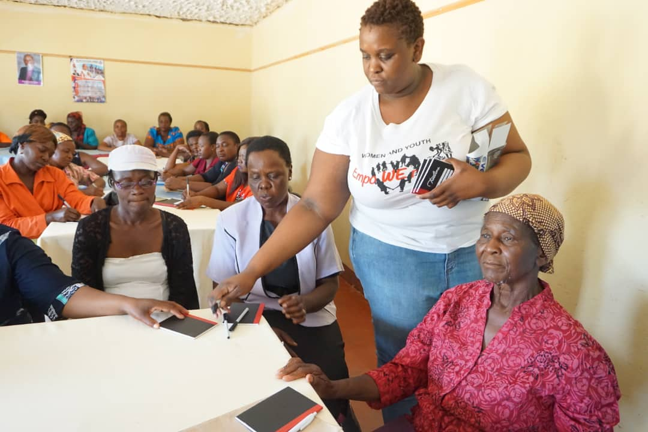
Health Care
©WDPIC
WDP Zimbabwe development program for families
with children with special needs
©WDPIC
©WDPIC

Slide 24
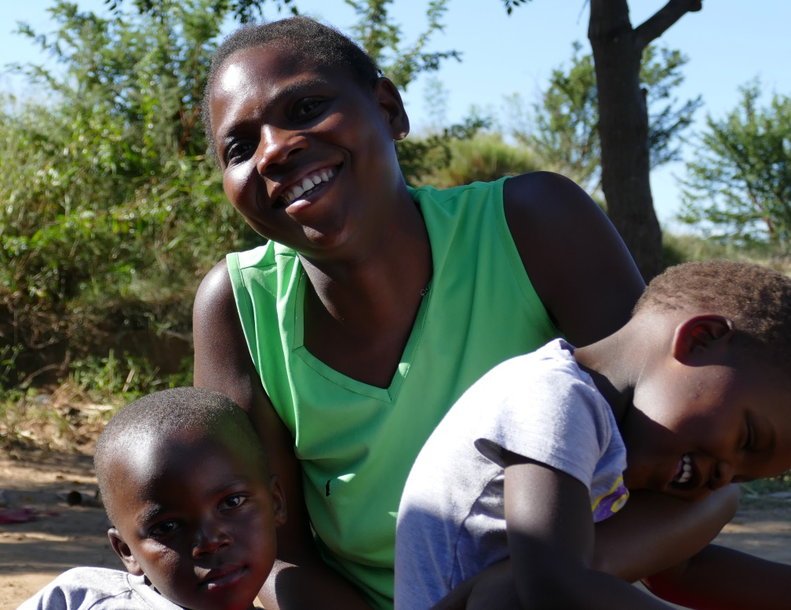
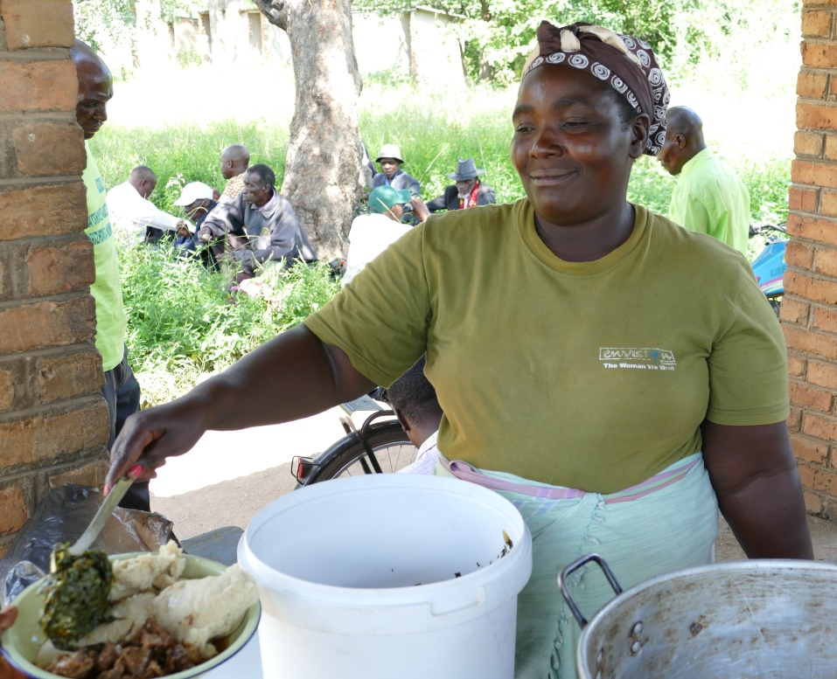
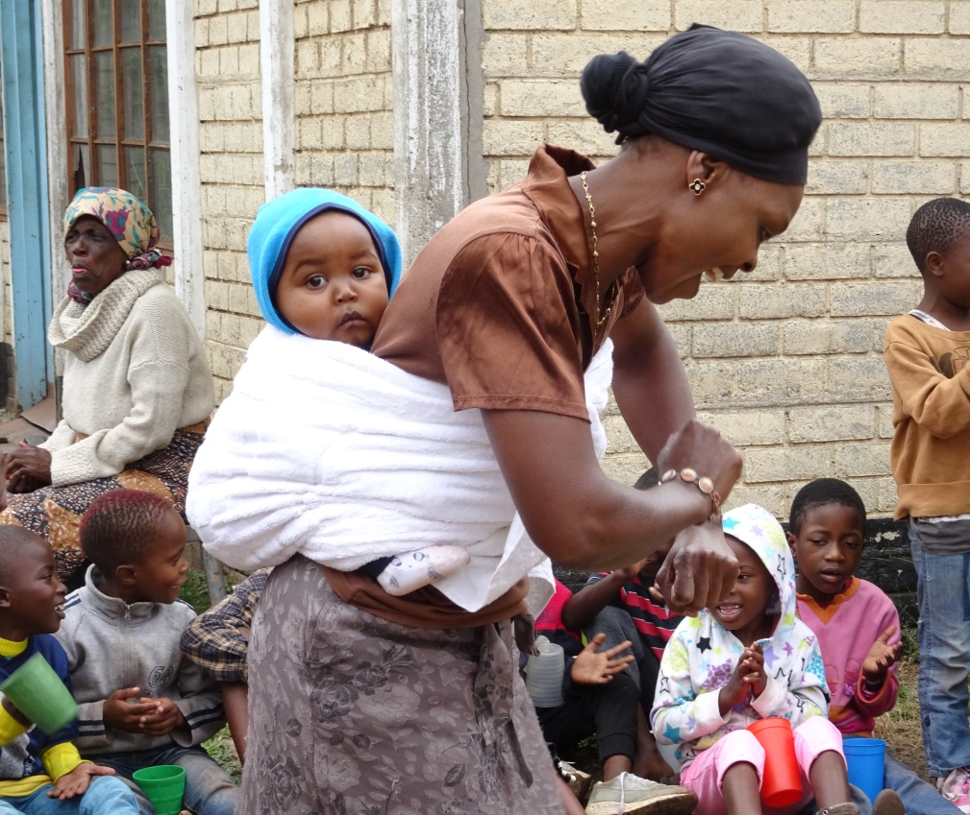
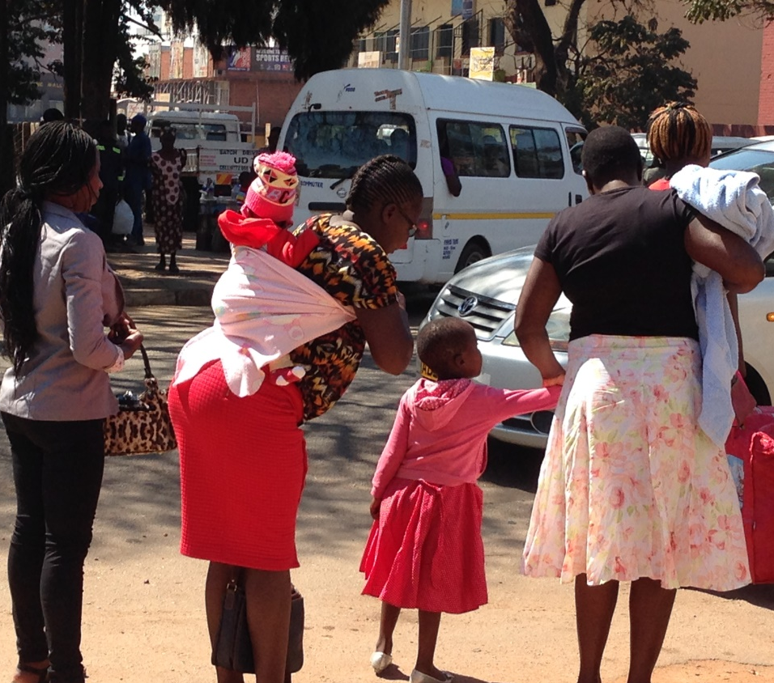
Women’s Rights
©wgt-ev
©wgt-ev
©wgt-ev
©WDPIC

Slide 25
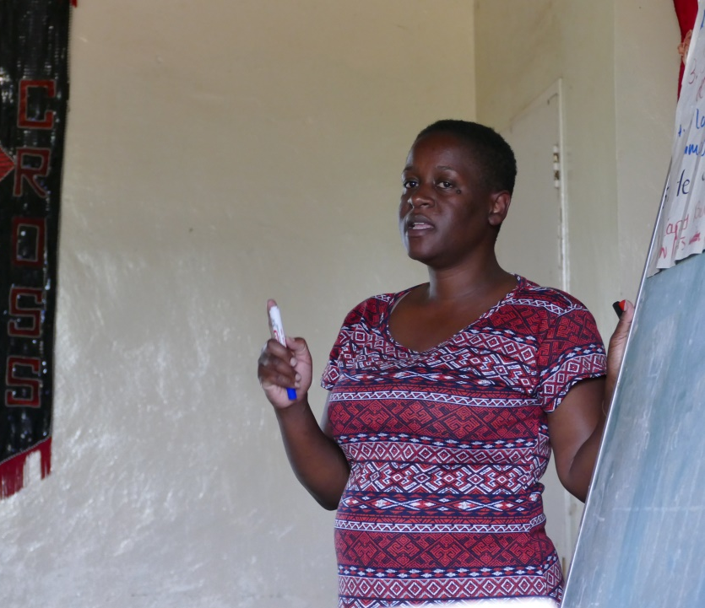
©wgt-ev

Slide 26
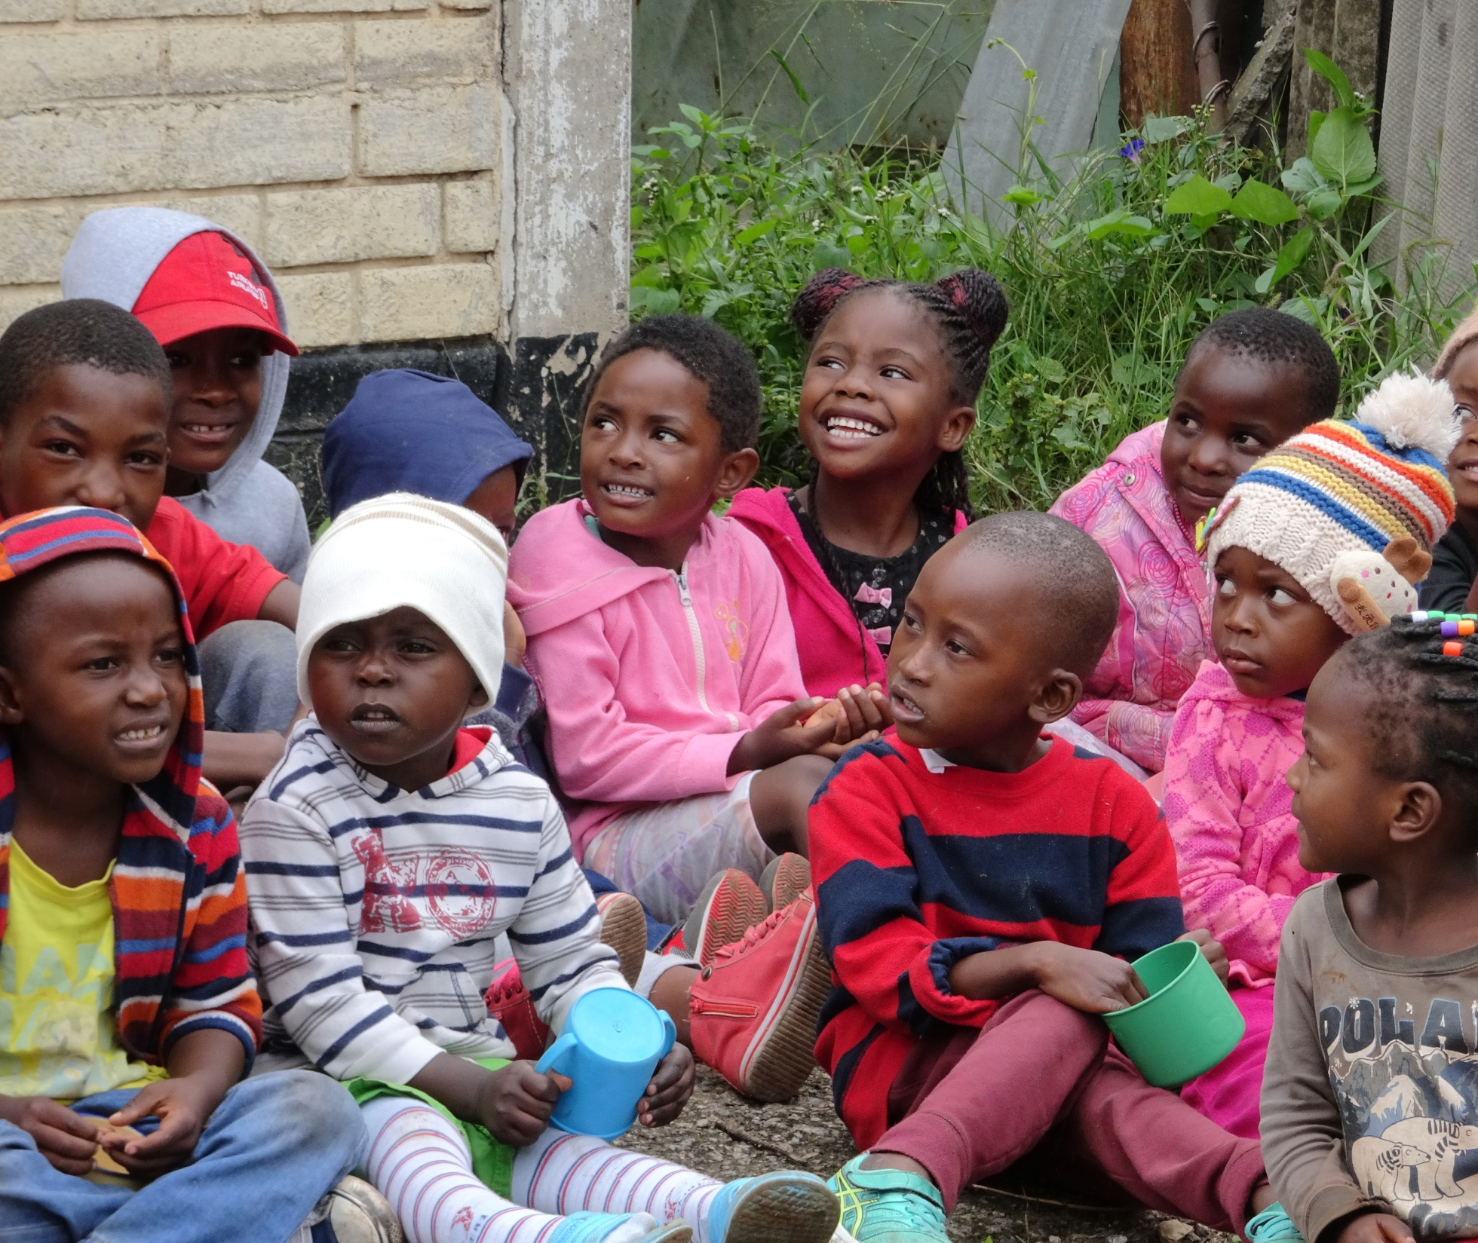
Children’s Rights
©wgt-ev

Slide 27
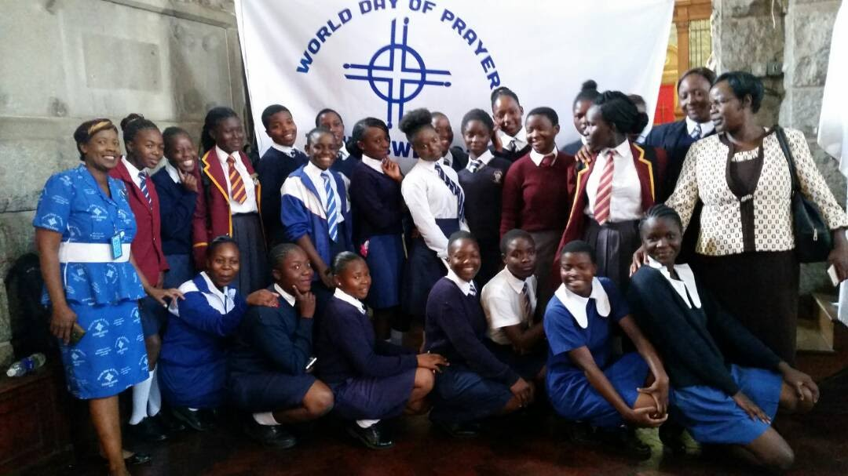
World Day of Prayer
©wgt-ev
Youth students participating in a WDP service in Harare

Slide 28
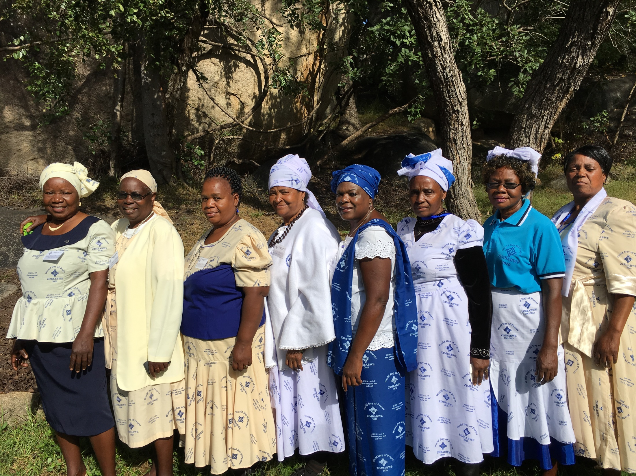
WDP Zimbabwe National Committee
©WDPIC

Slide 29
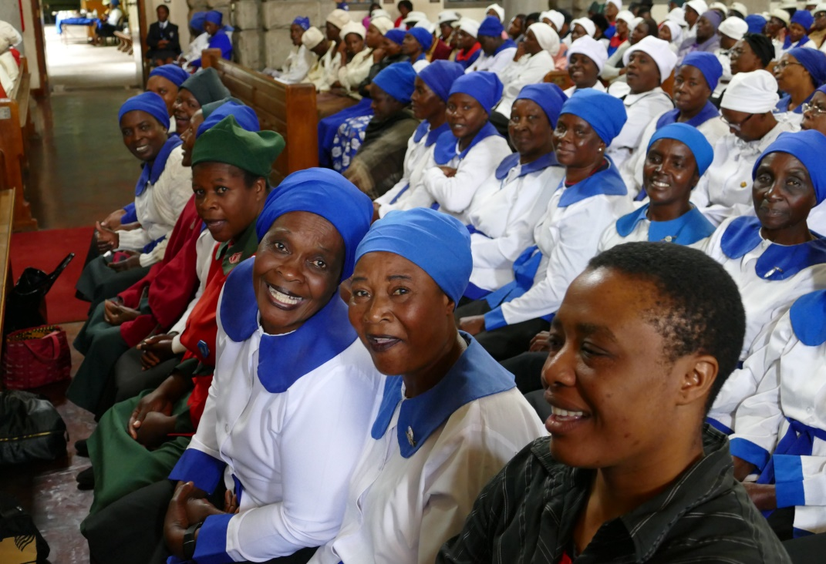
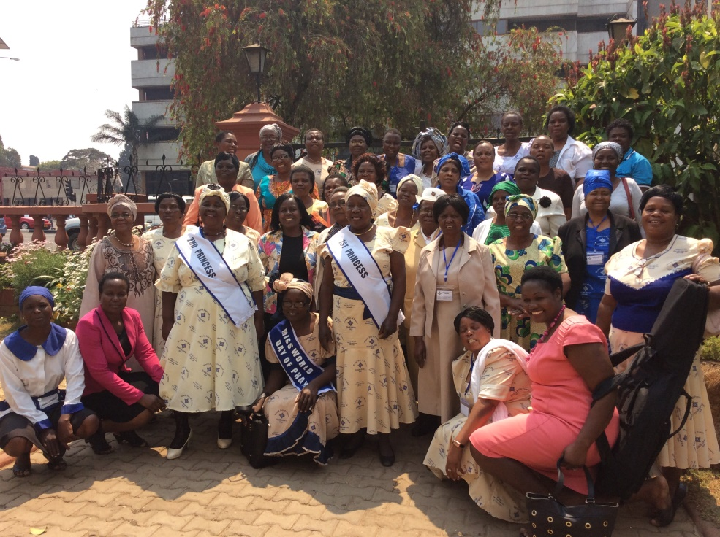
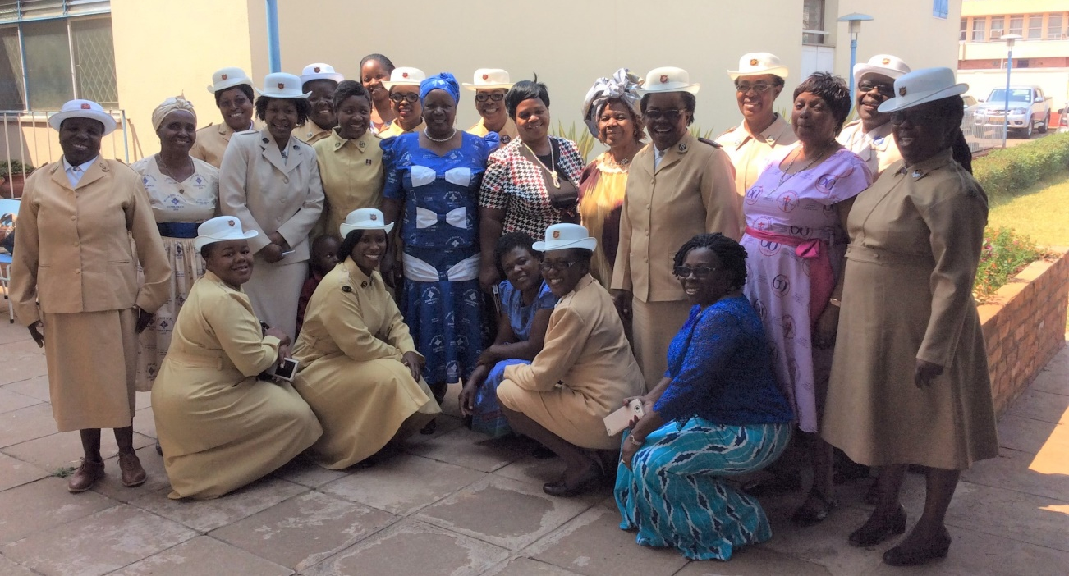
©wgt-ev
©WDPIC
WDP Service in Zimbabwe
WDP Annual General Meeting
©WDPIC
WDPIC Visits Salvation Army

Slide 30
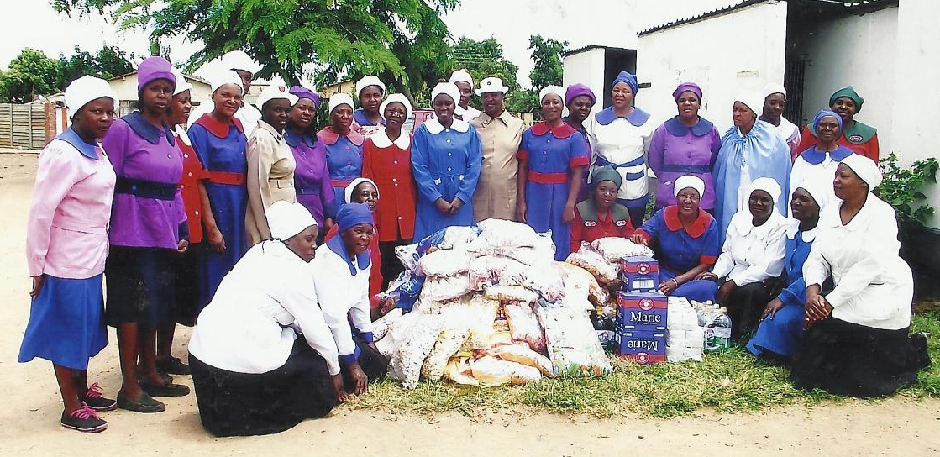
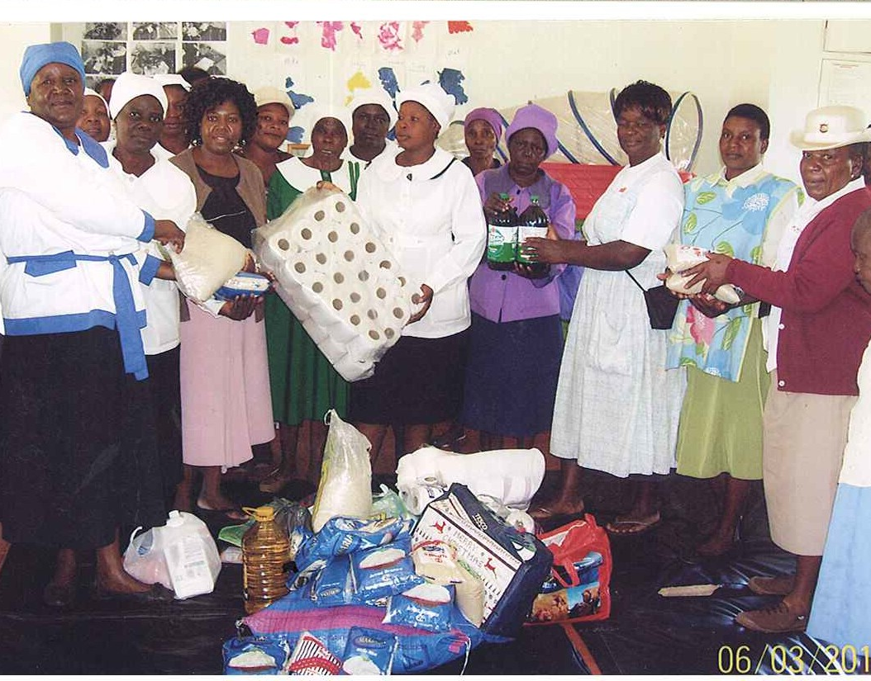
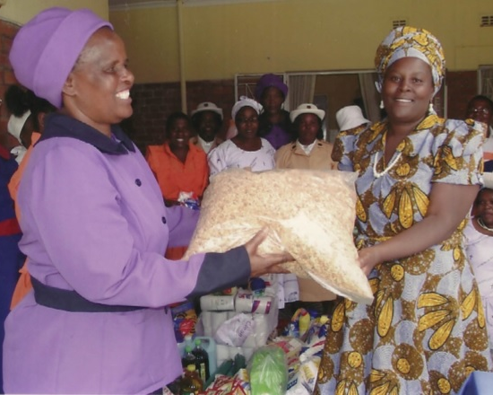
WDP Donations to local communities
2014 ©WDPIC
2015 ©WDPIC
2016 ©WDPIC

Slide 31
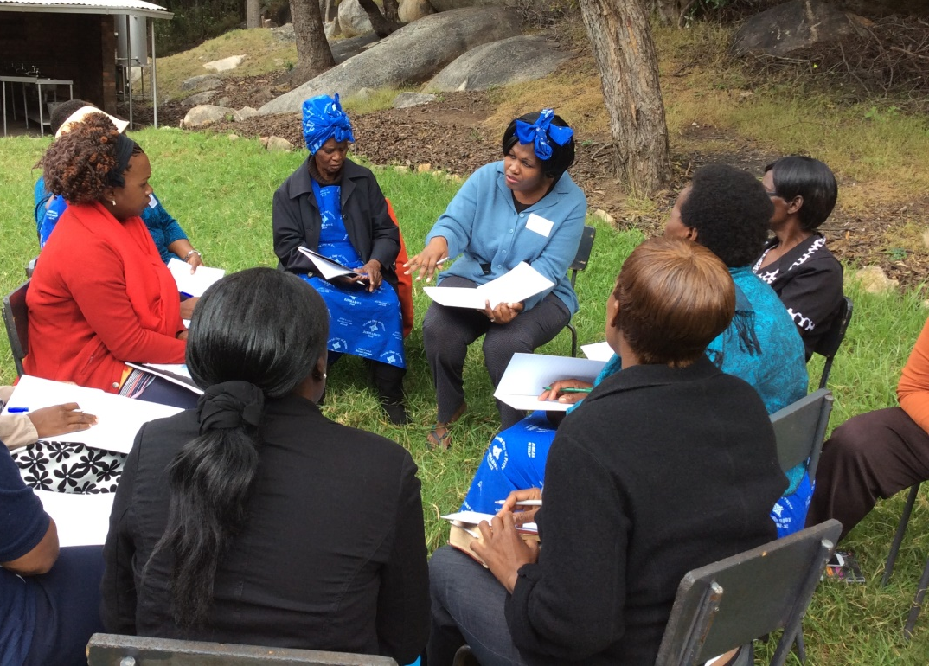
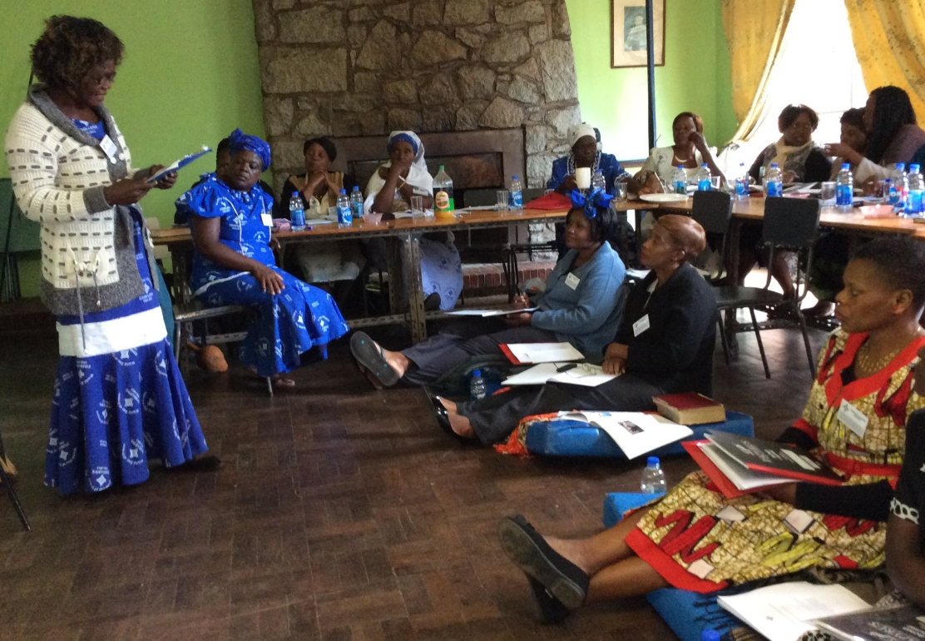


©WDPIC
©WDPIC
2017 WDP Writer Workshop
©WDPIC
©WDPIC

Slide 32


2016 Strengthening National Committee Workshop
©WDPIC
©WDPIC

Slide 33


Artist & Painting
Nonhlanhla Mathe

