Slide 1
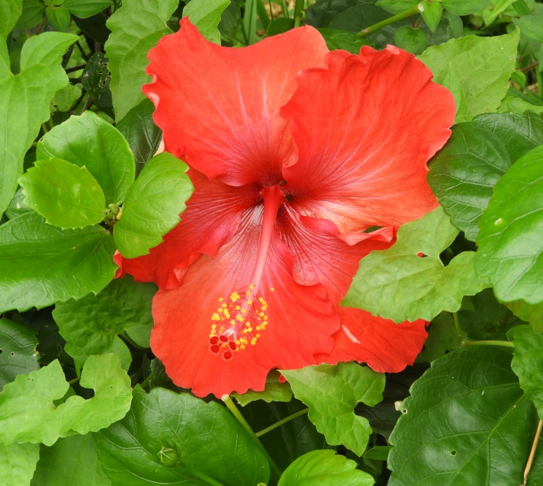
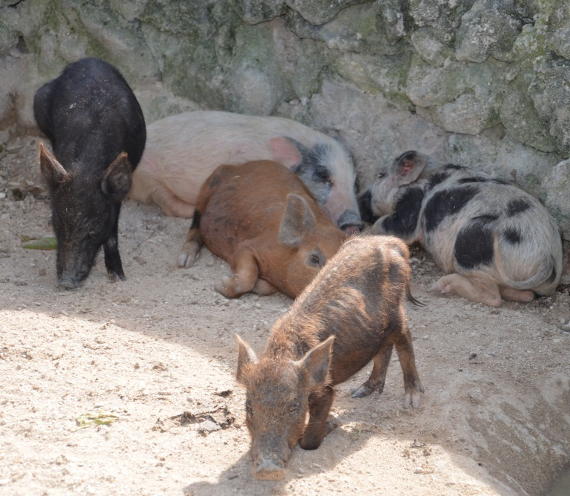
WORLD DAY OF PRAYER 2021
WRITTEN BY THE WOMEN OF
WDP VANUATU
“BUILD ON A STRONG FOUNDATION”
​MATTHEW 7:24-27

Slide 2
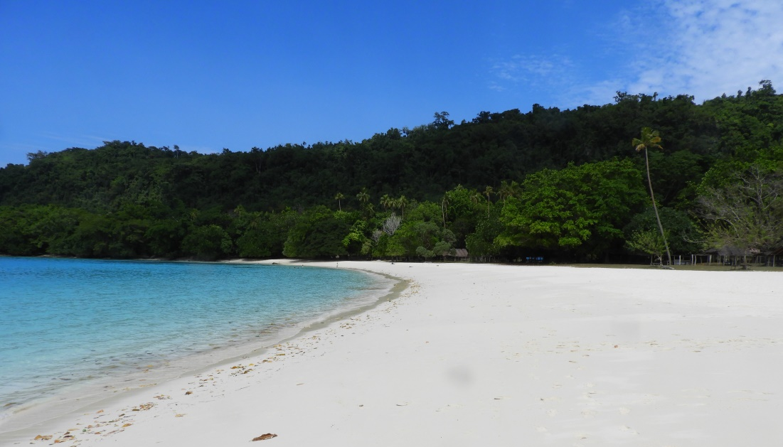
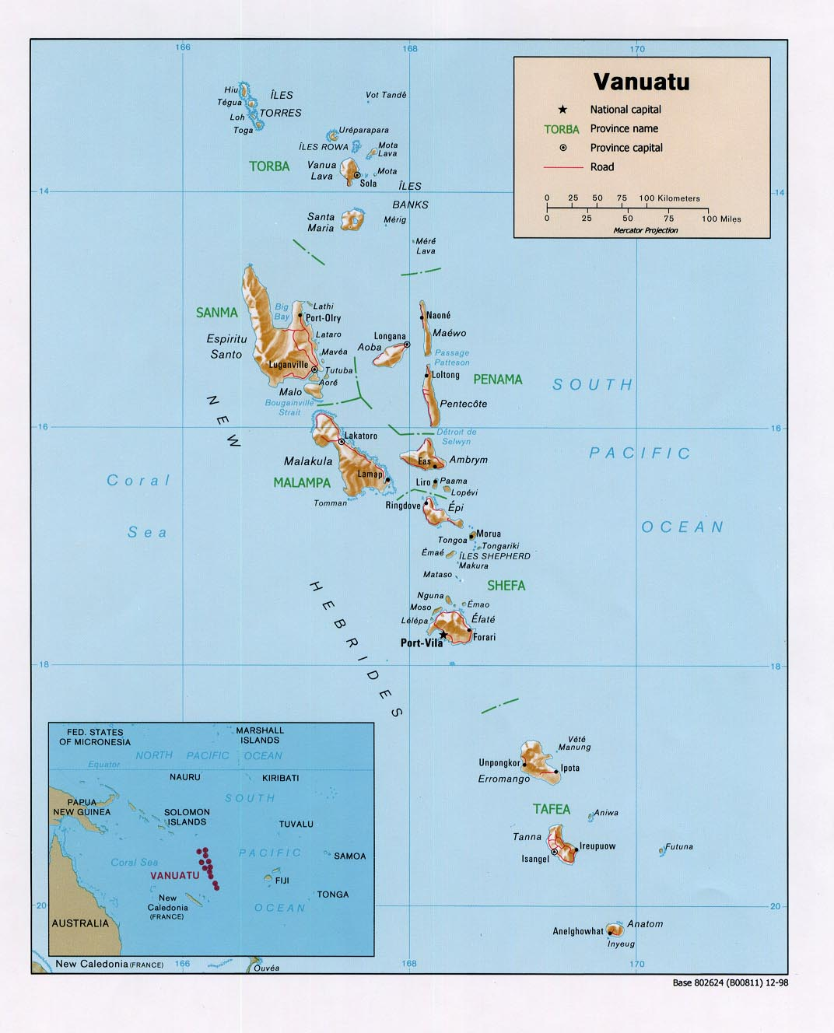
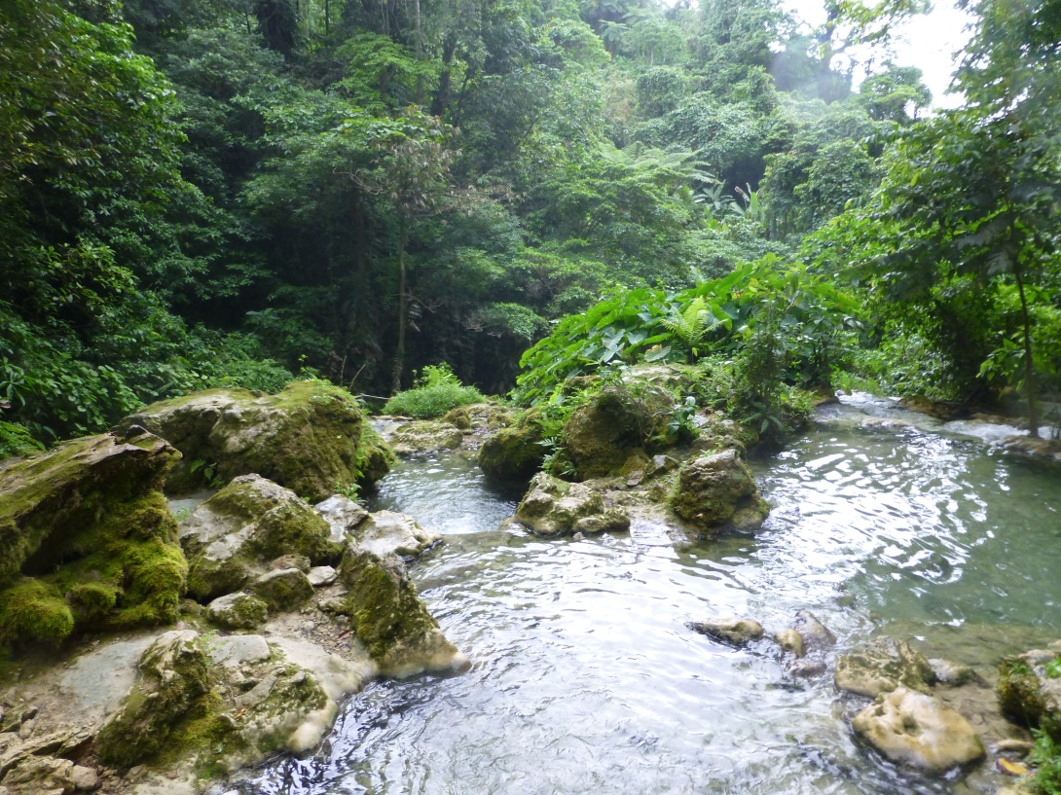
Geography & Population
Champagne Beach, Espiritu Santo

Slide 3
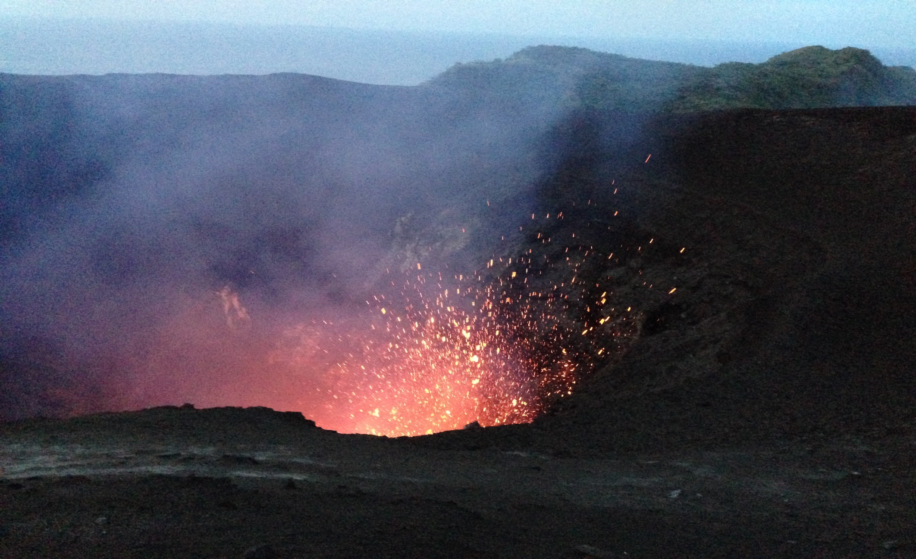
Geography & Population
Mount Yasur Volcano

Slide 4
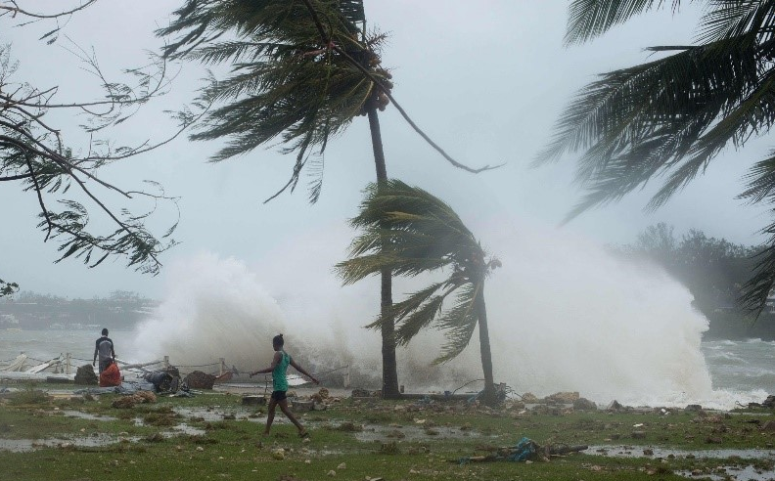
Geography & Population
Cyclone Pam, March 2015
©Roselyn Tor

Slide 5
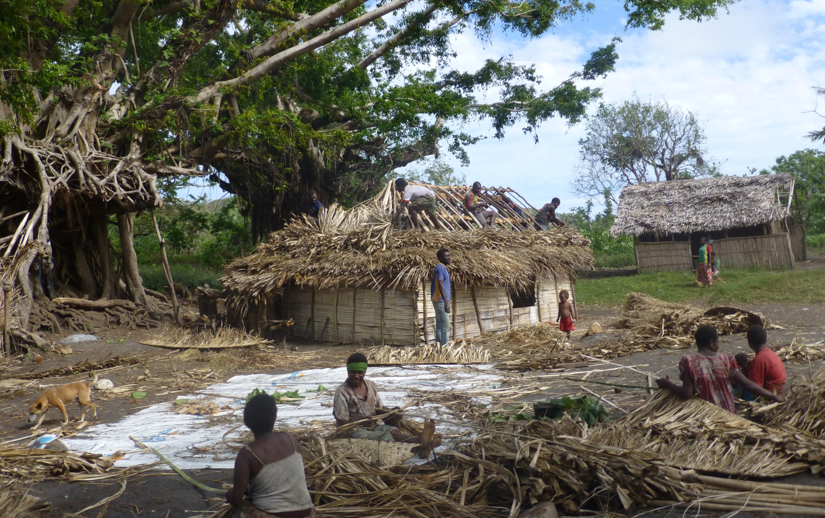
Geography & Population
Rebuilding

Slide 6
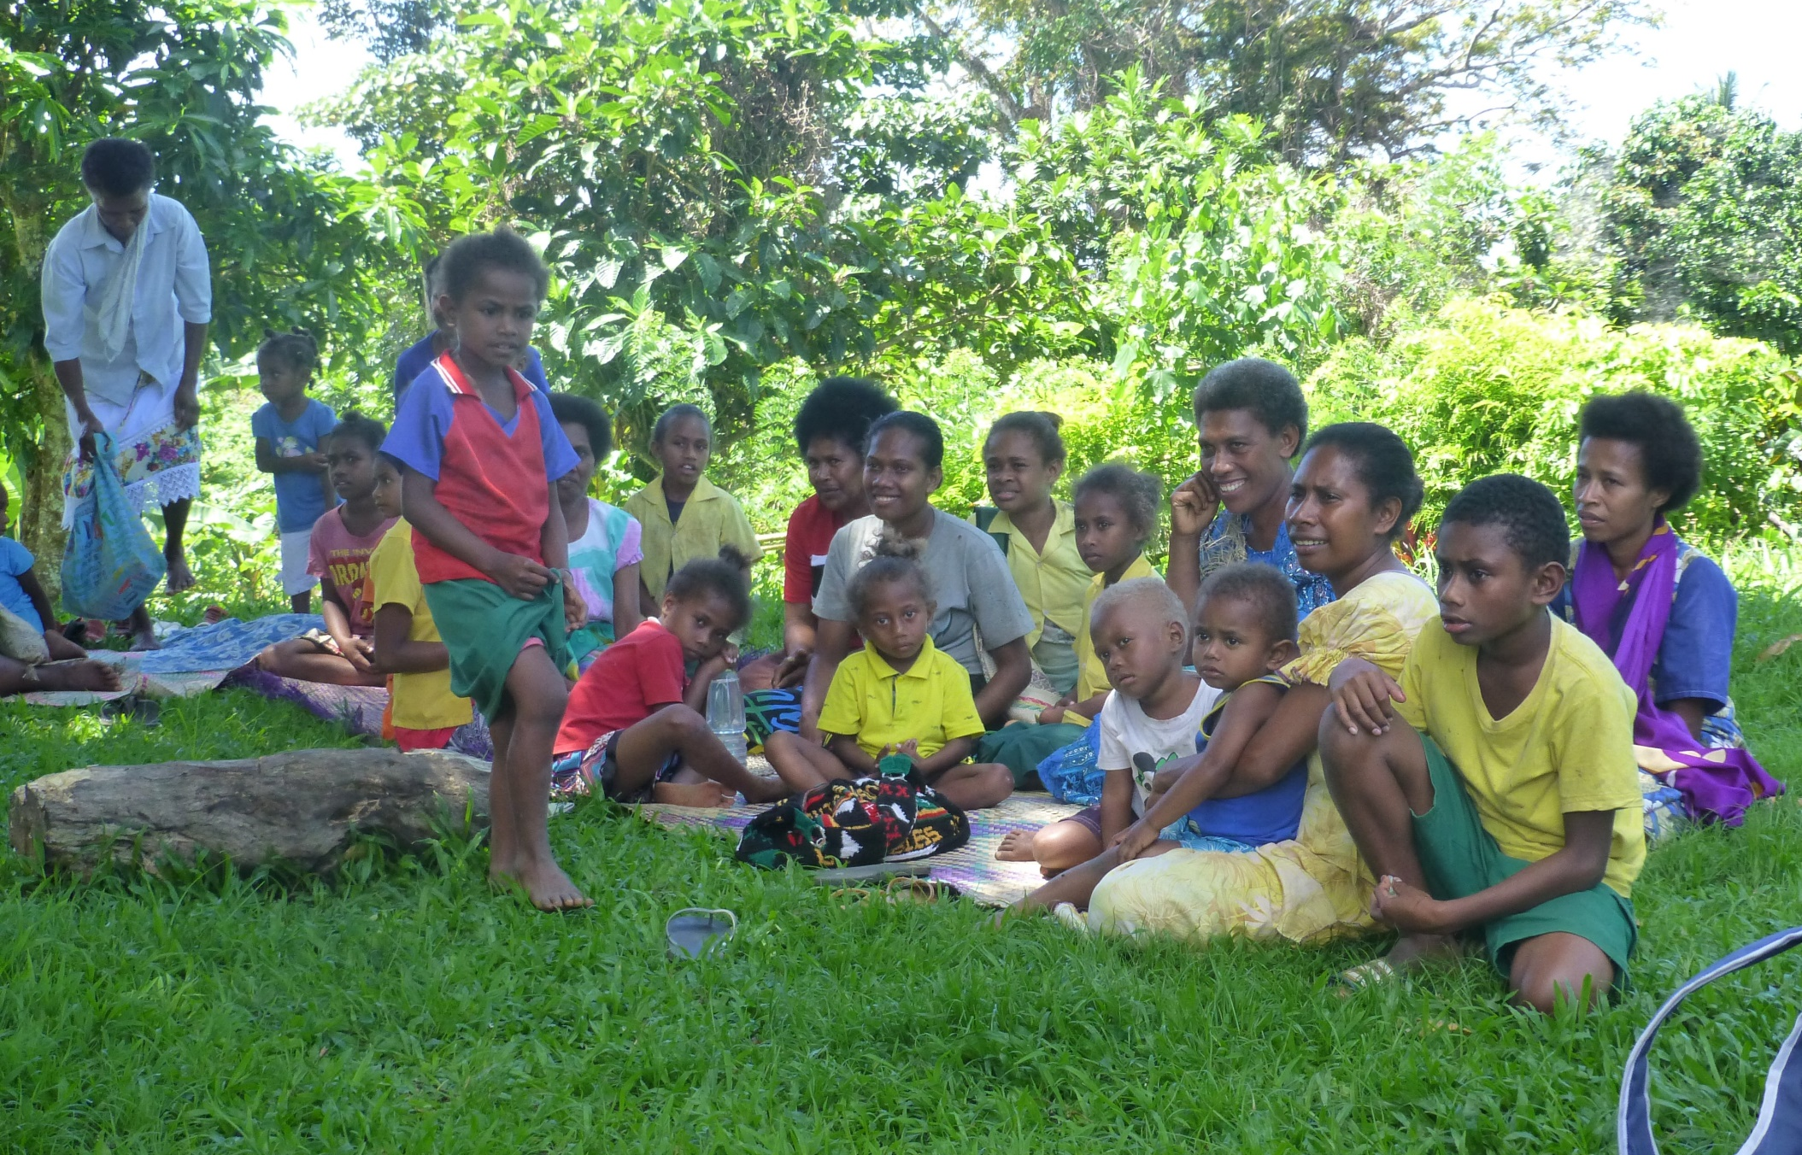
Geography & Population

Slide 7
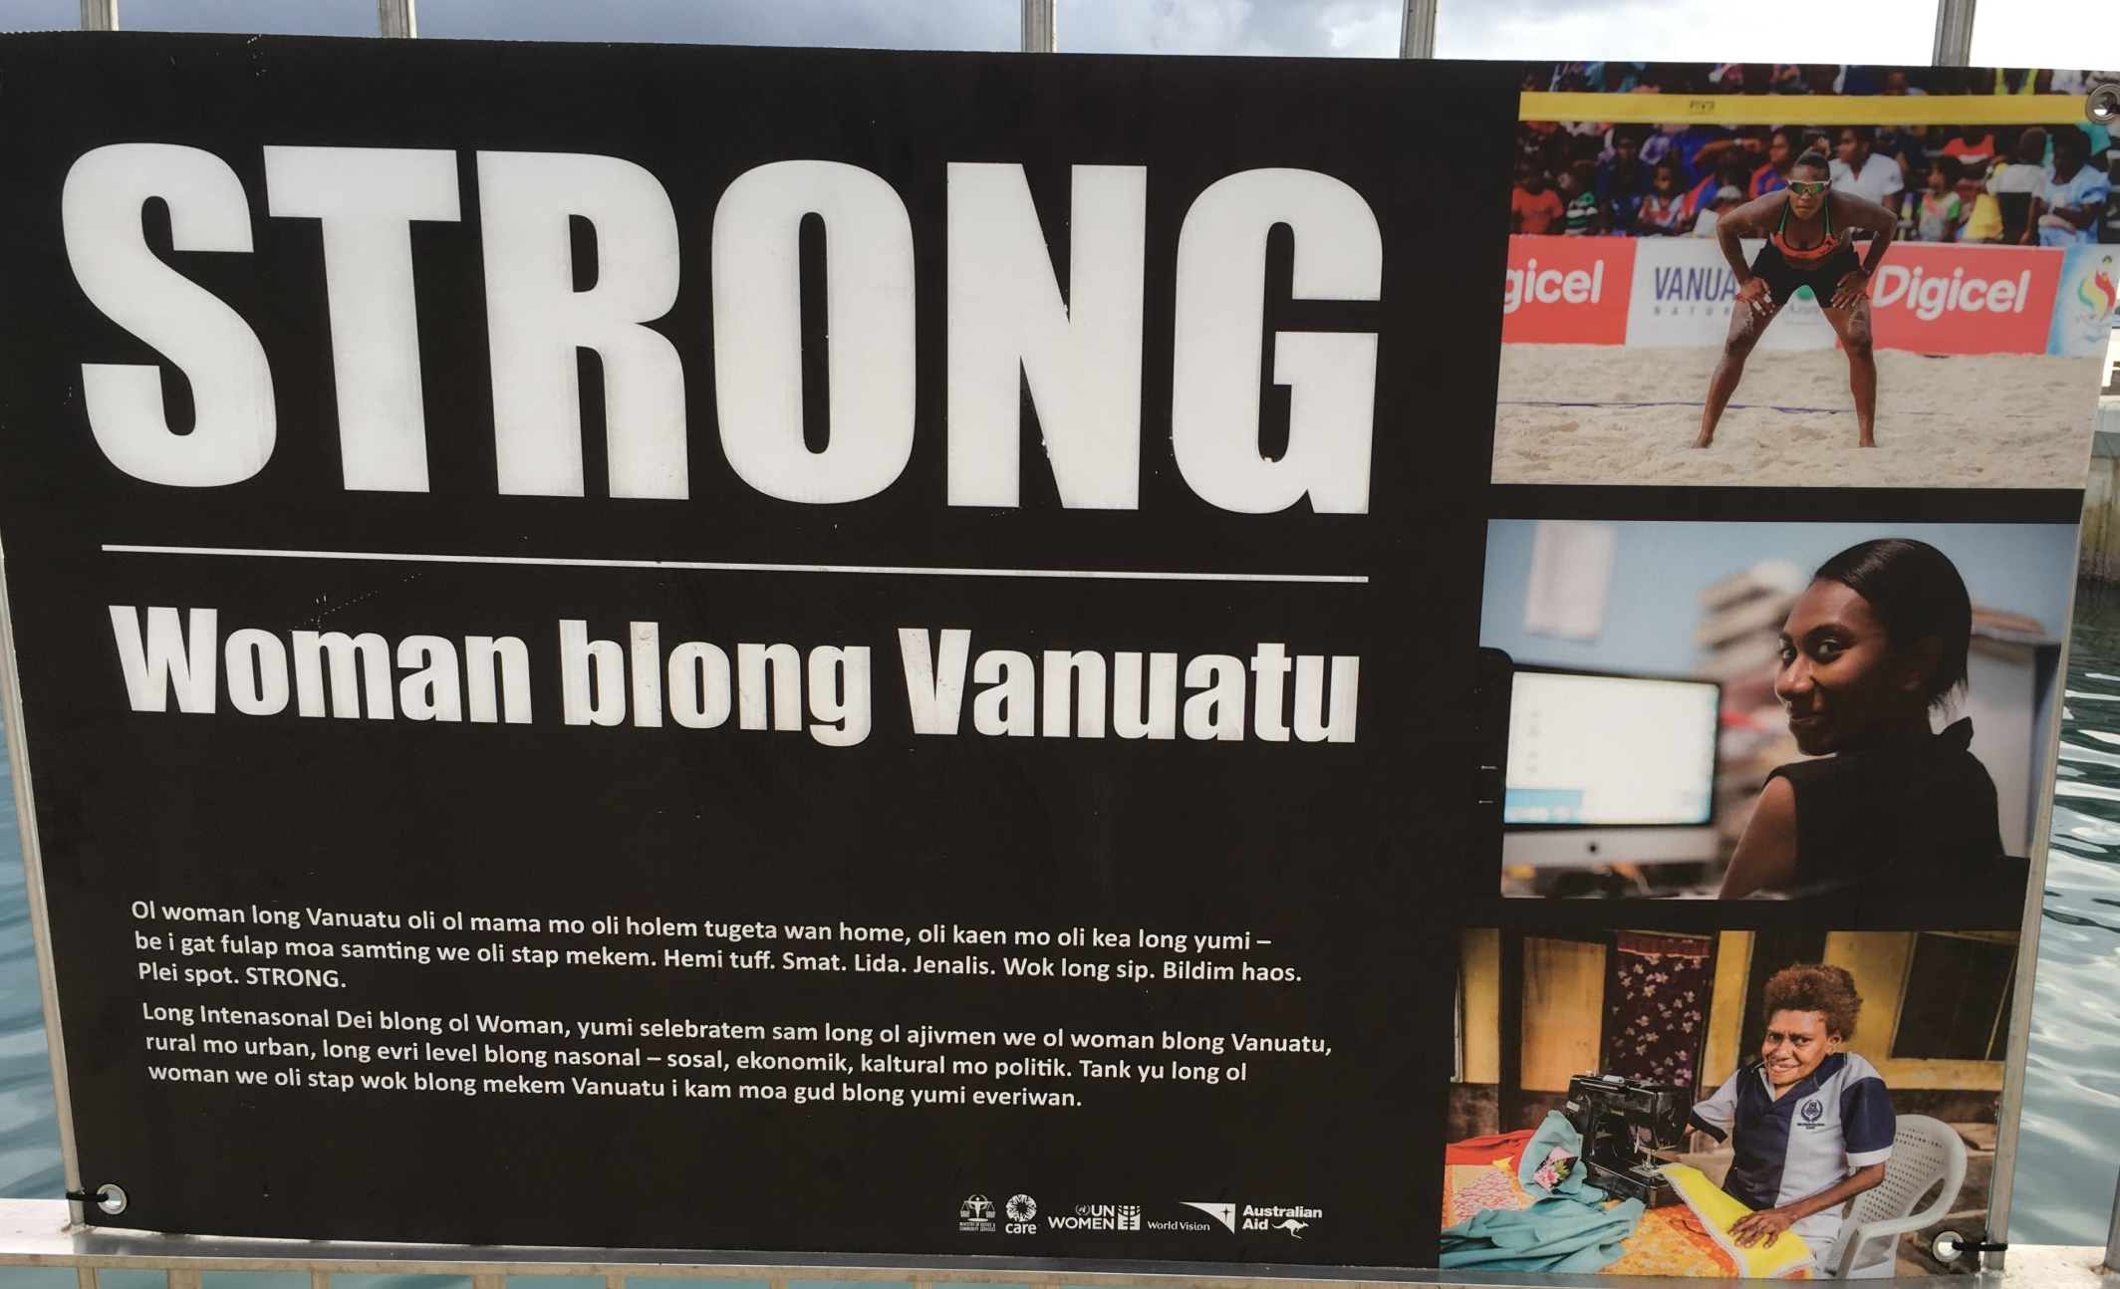
Geography & Population
Poster in Bislama

Slide 8
Geography & Population

Slide 9
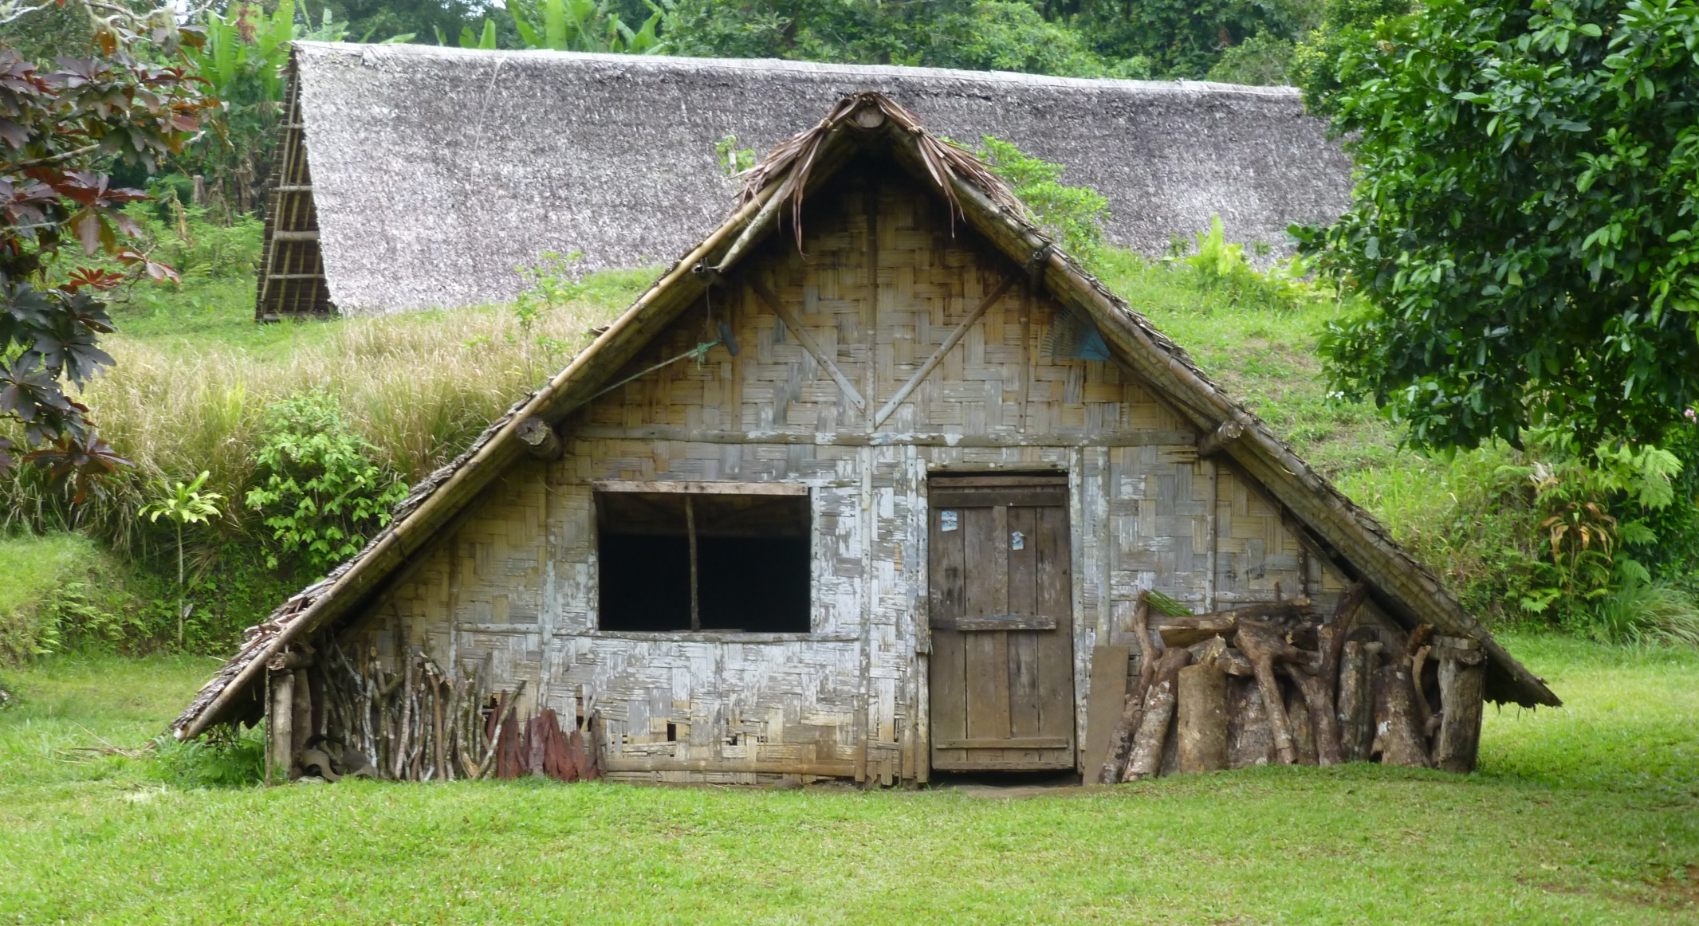
Political History
Thatched House

Slide 10
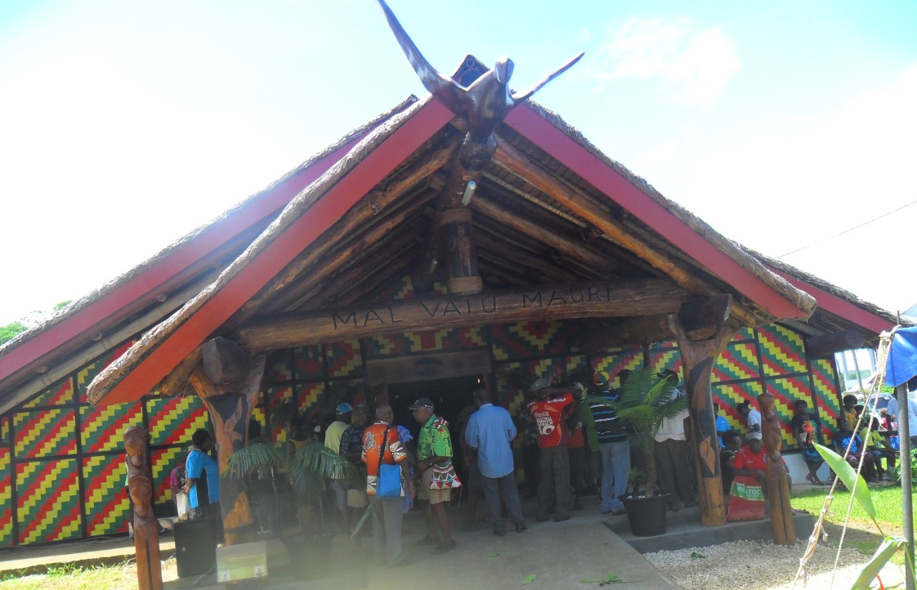
Political History
Malvatumauri National Council of Chiefs
©Roselyn Tor

Slide 11
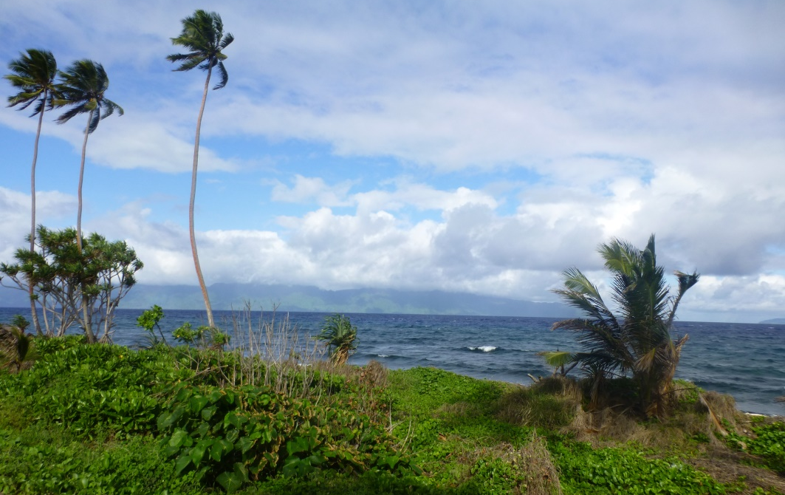
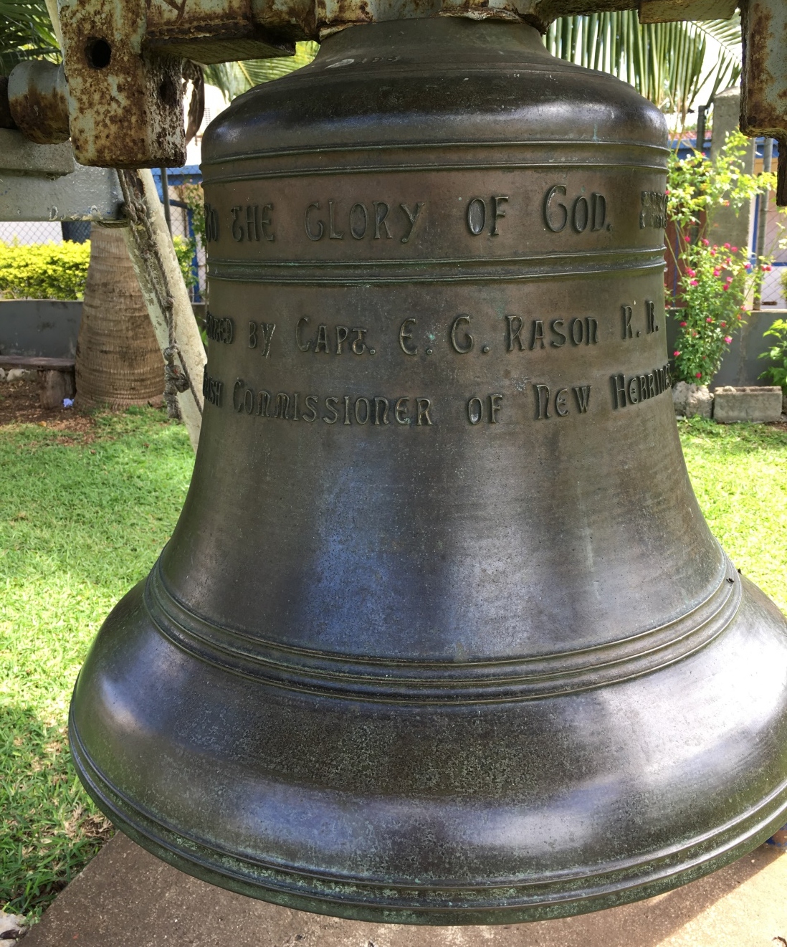
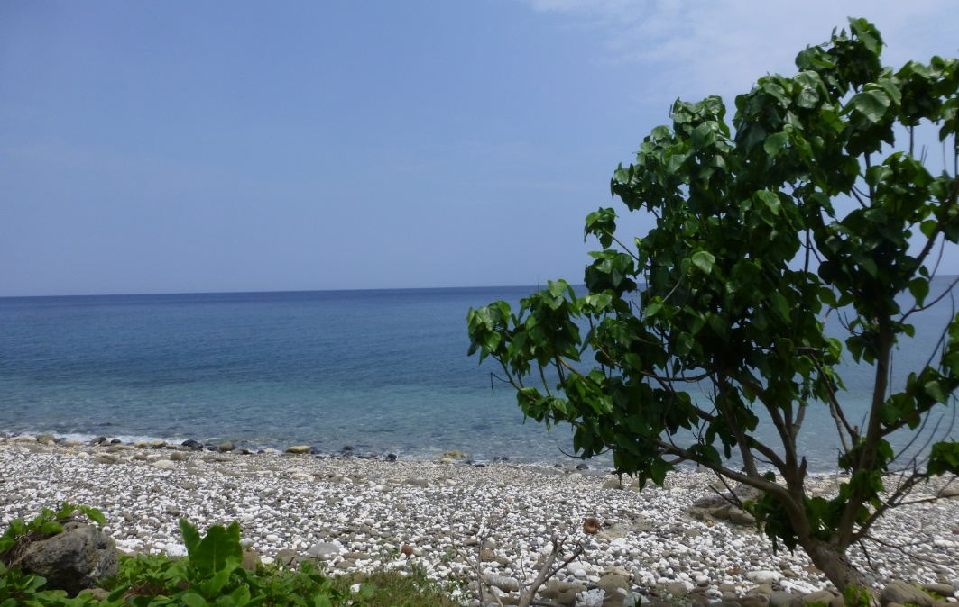
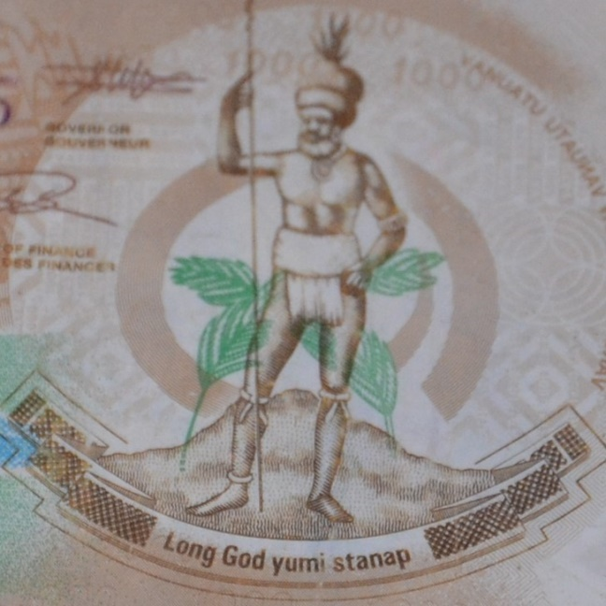
Political History
Coast of Ambae Island
Pentecost Island

Slide 12
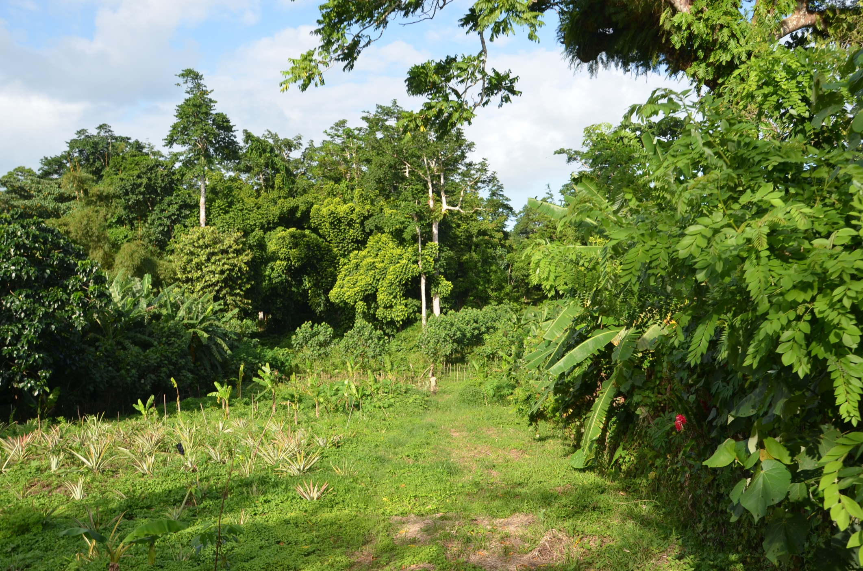
Economy

Slide 13
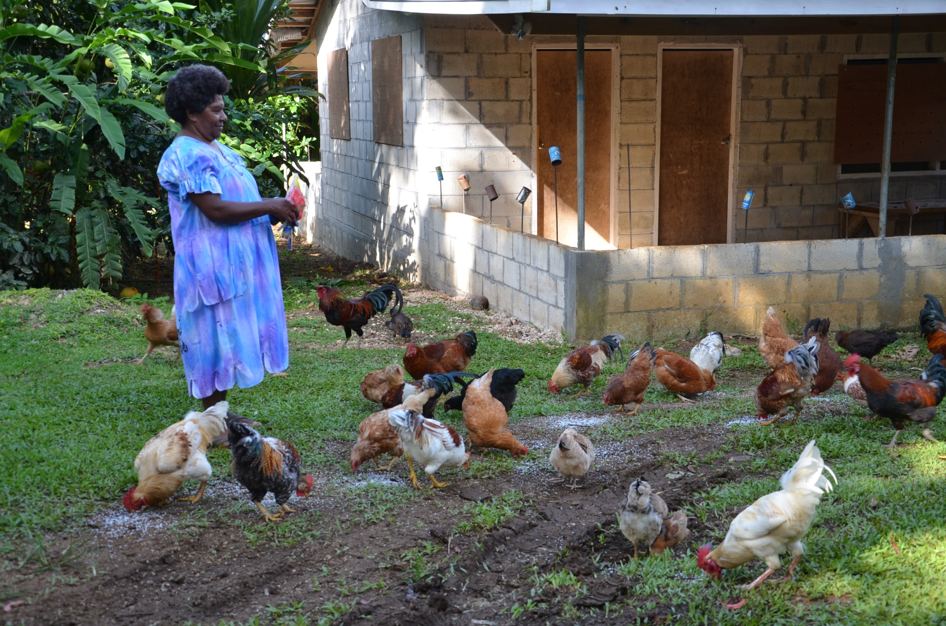
Economy

Slide 14
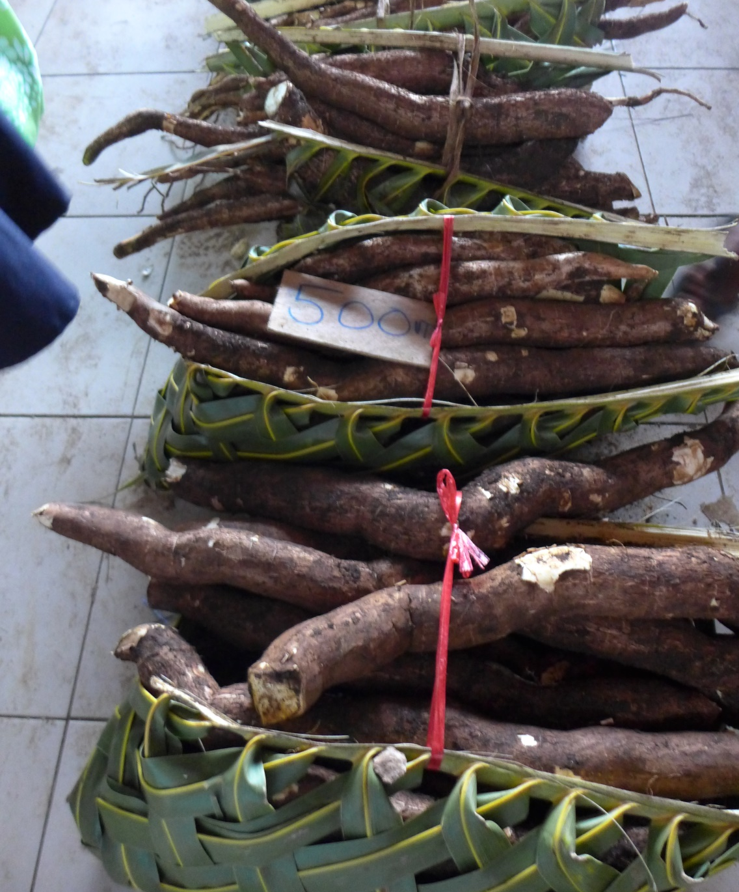
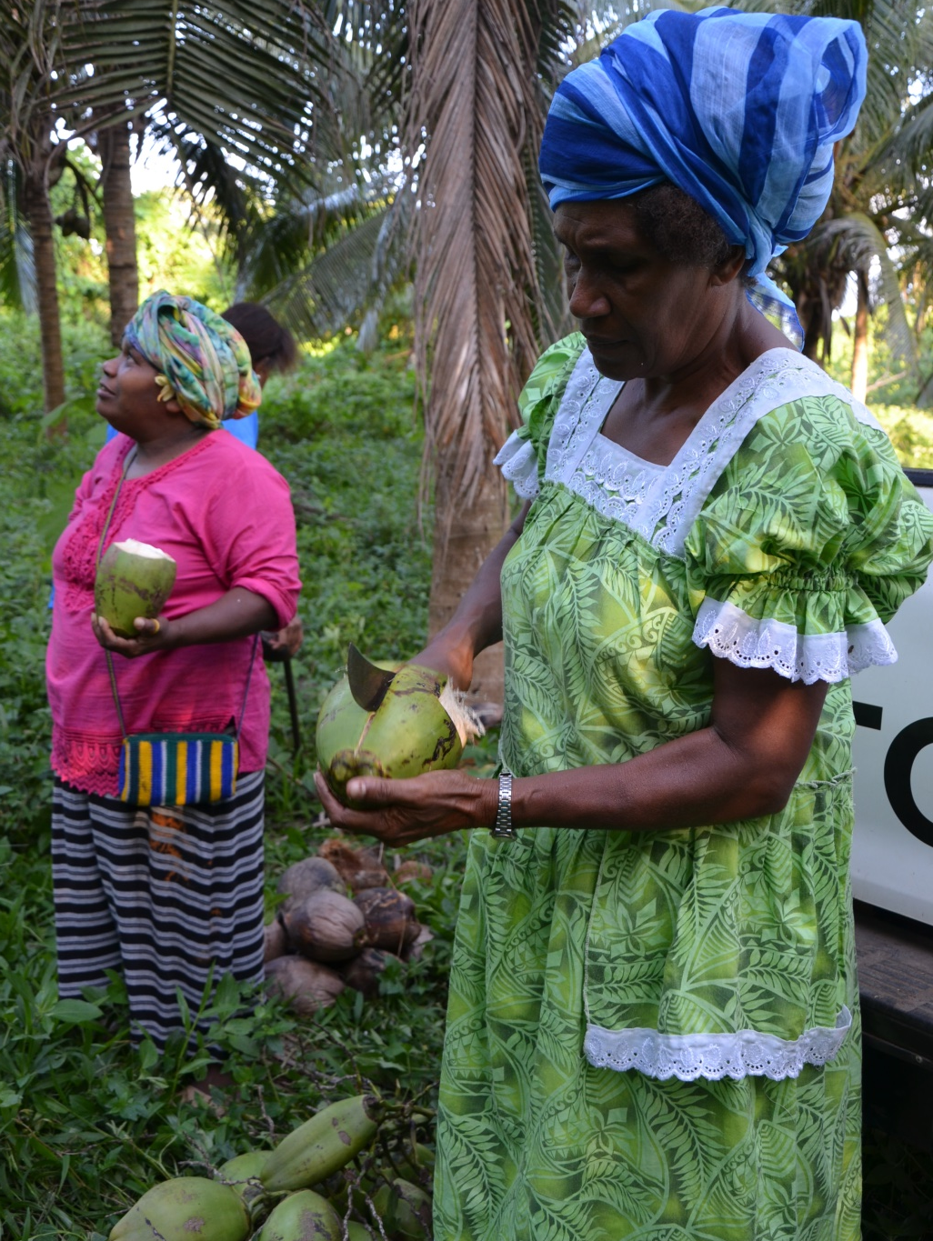
Economy
Coconut
Cassava

Slide 15
Economy

Slide 16
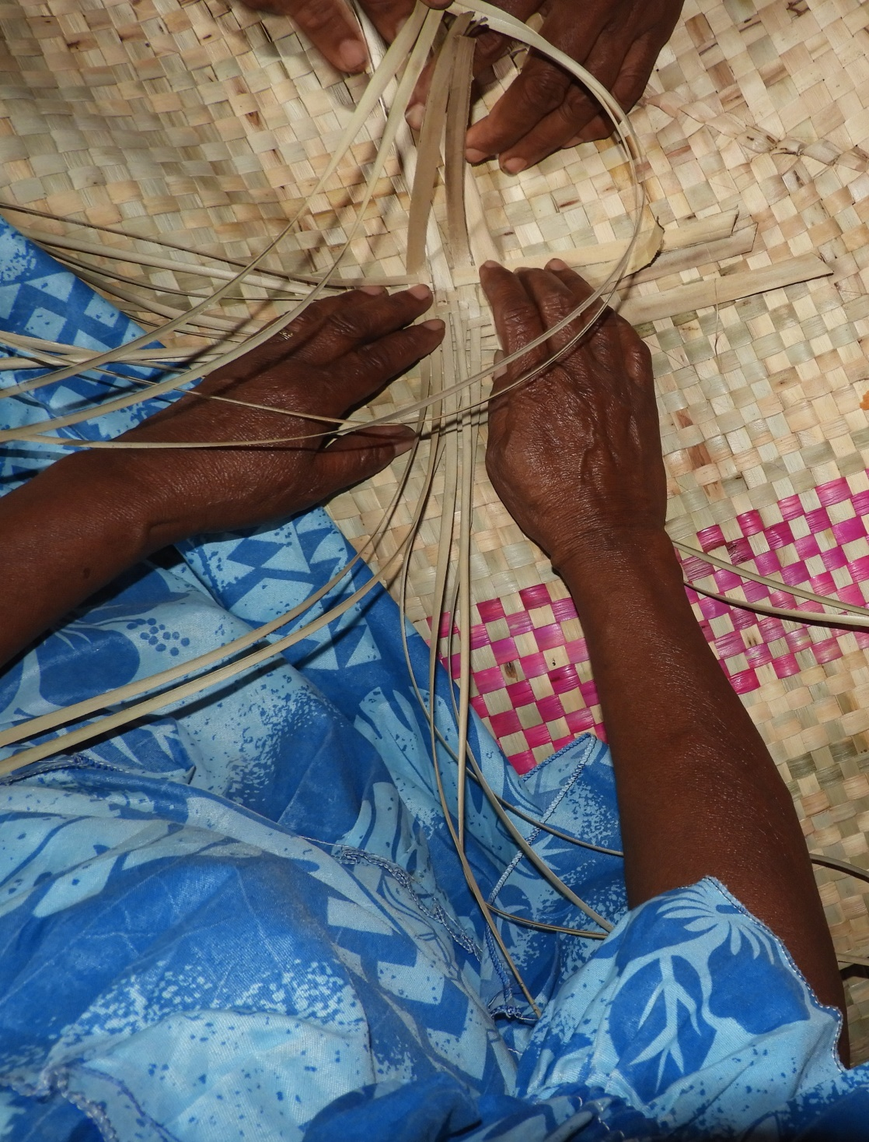
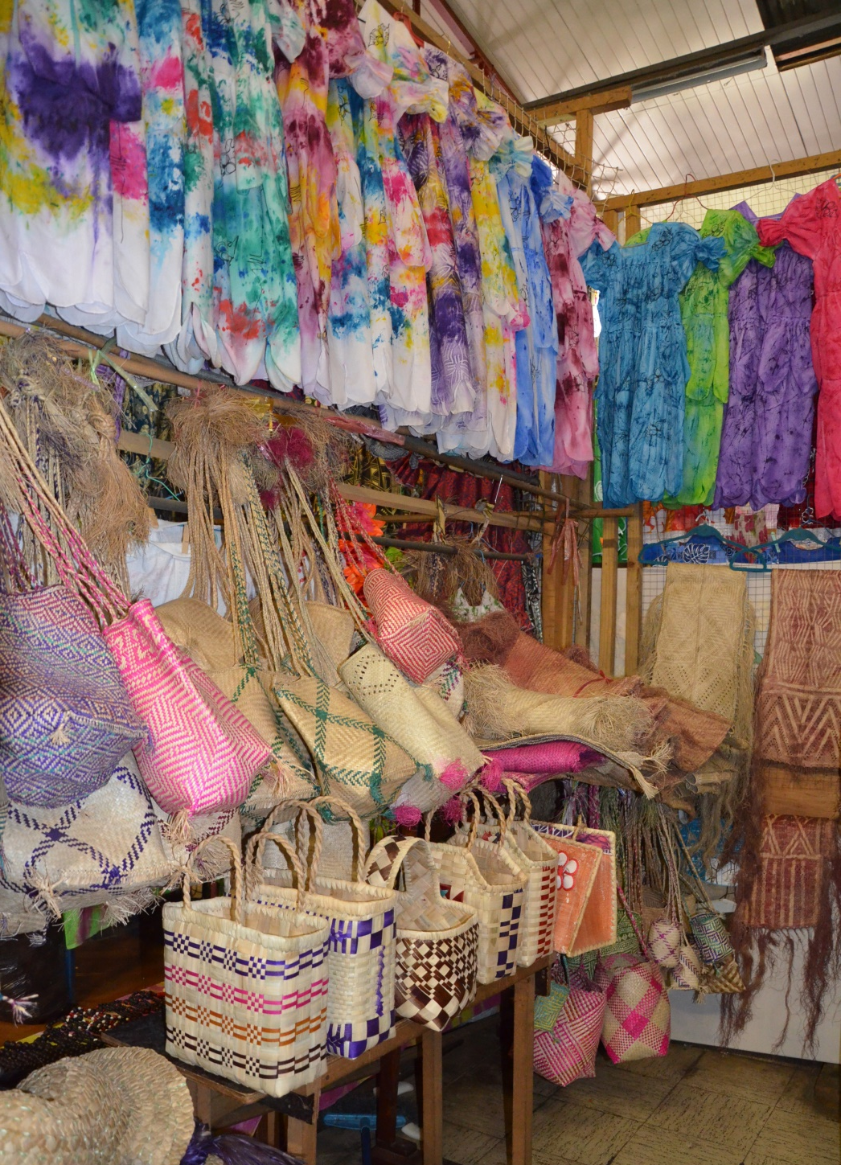
Economy

Slide 17
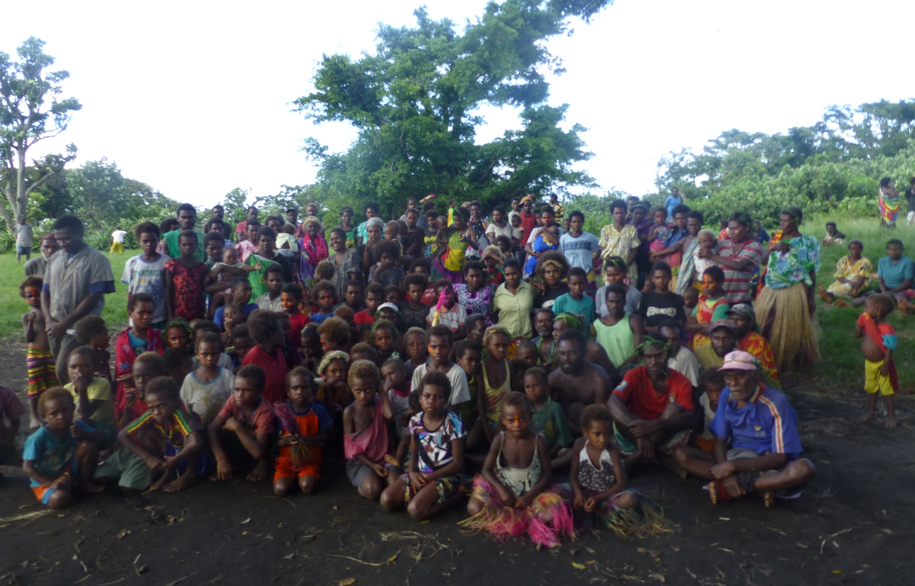
Economy

Slide 18
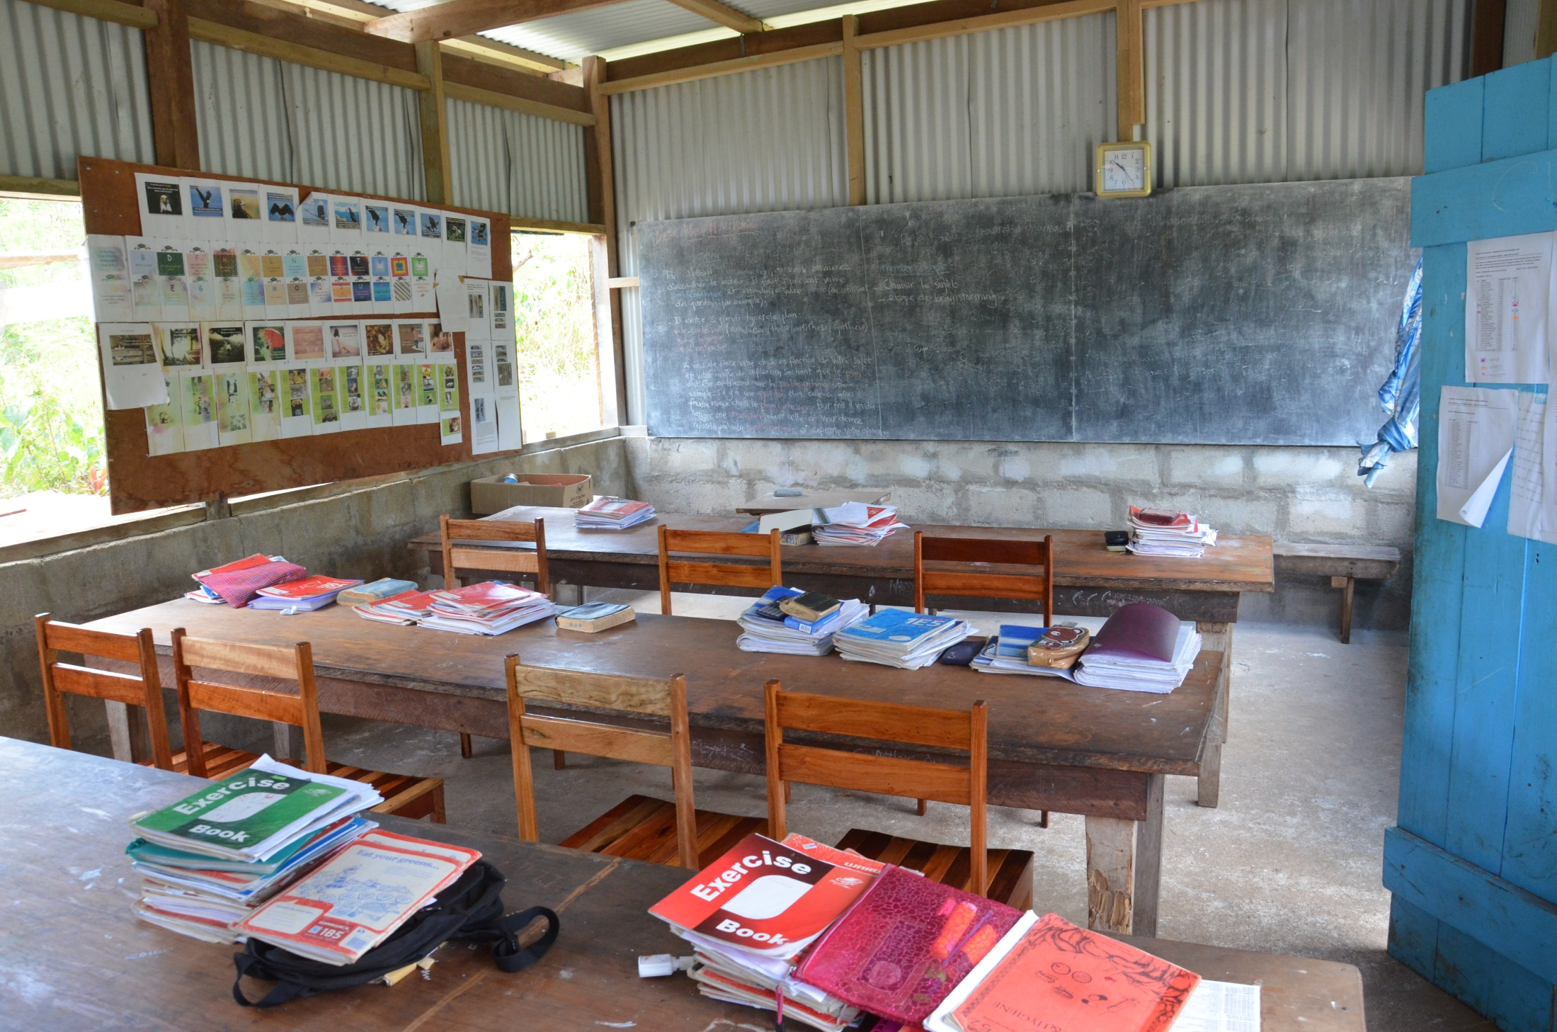
Education

Slide 19
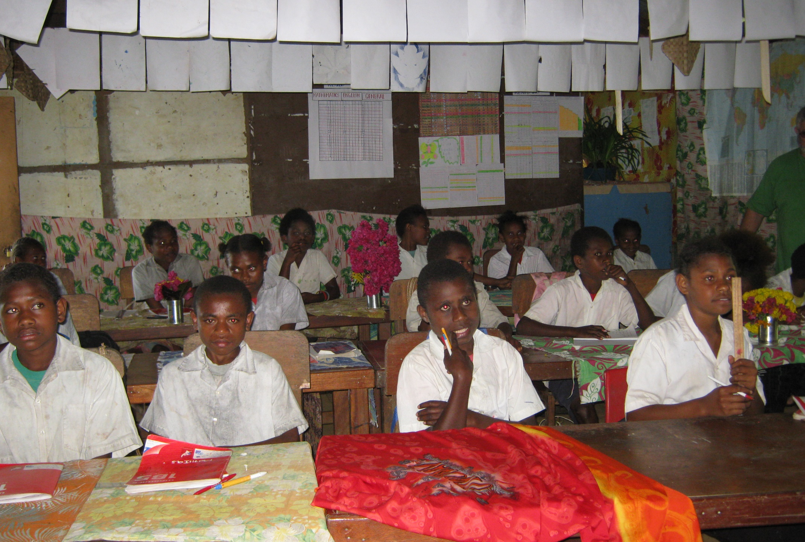
Education

Slide 20
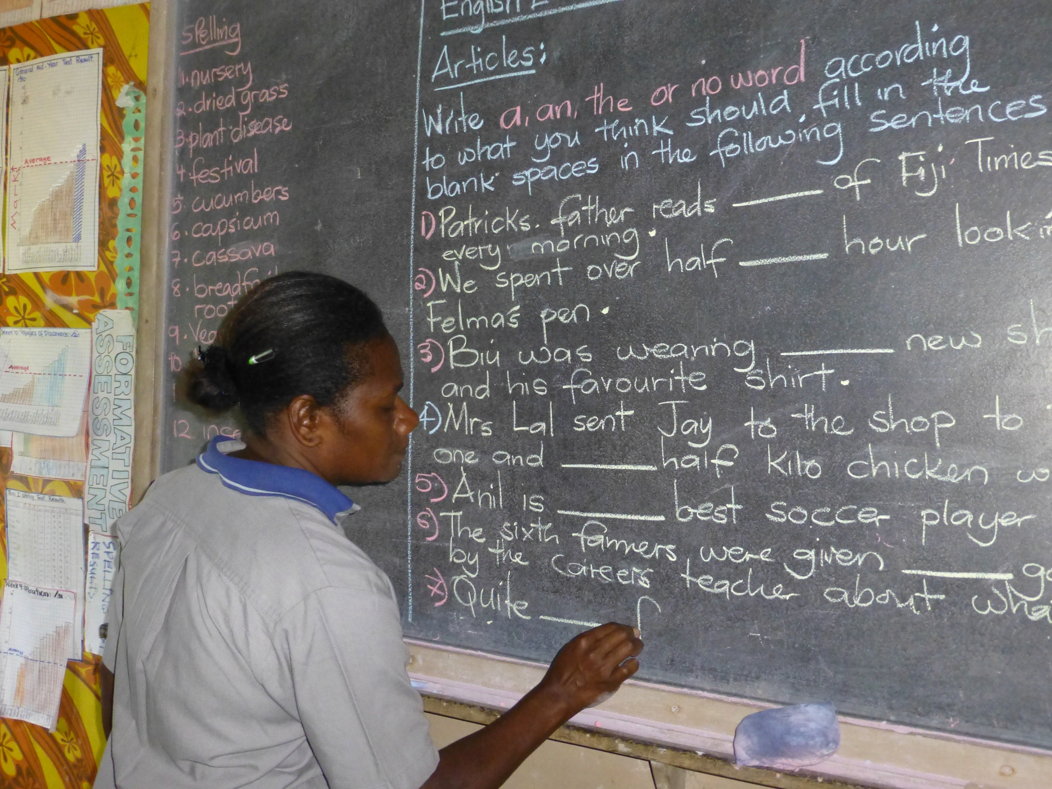
Education

Slide 21
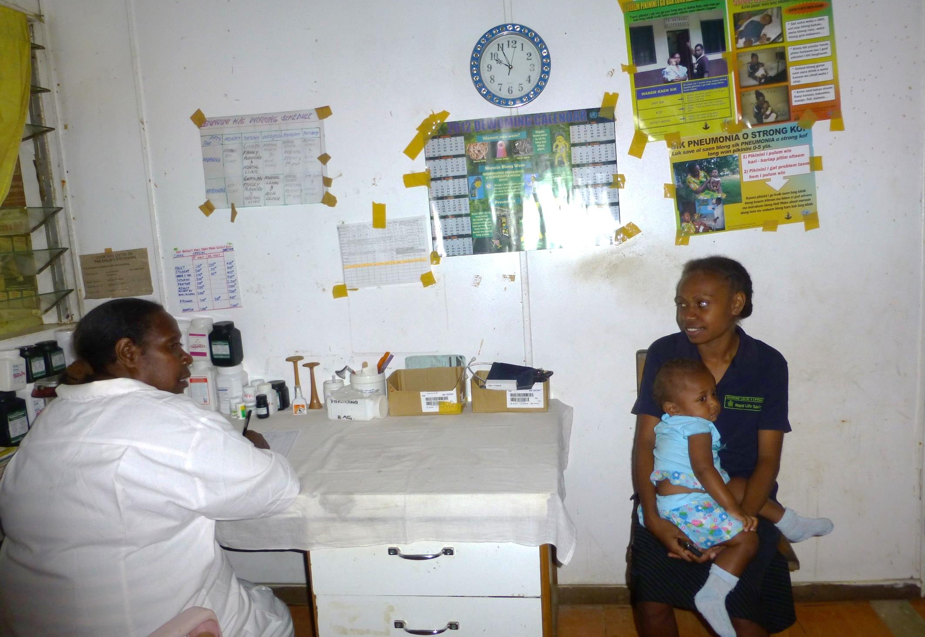
Healthcare

Slide 22
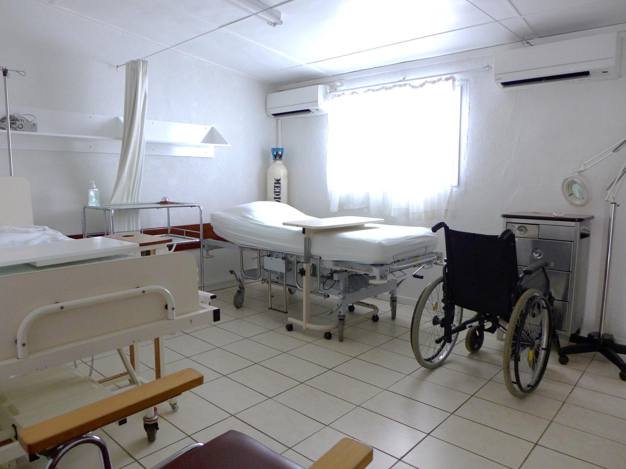
Healthcare

Slide 23
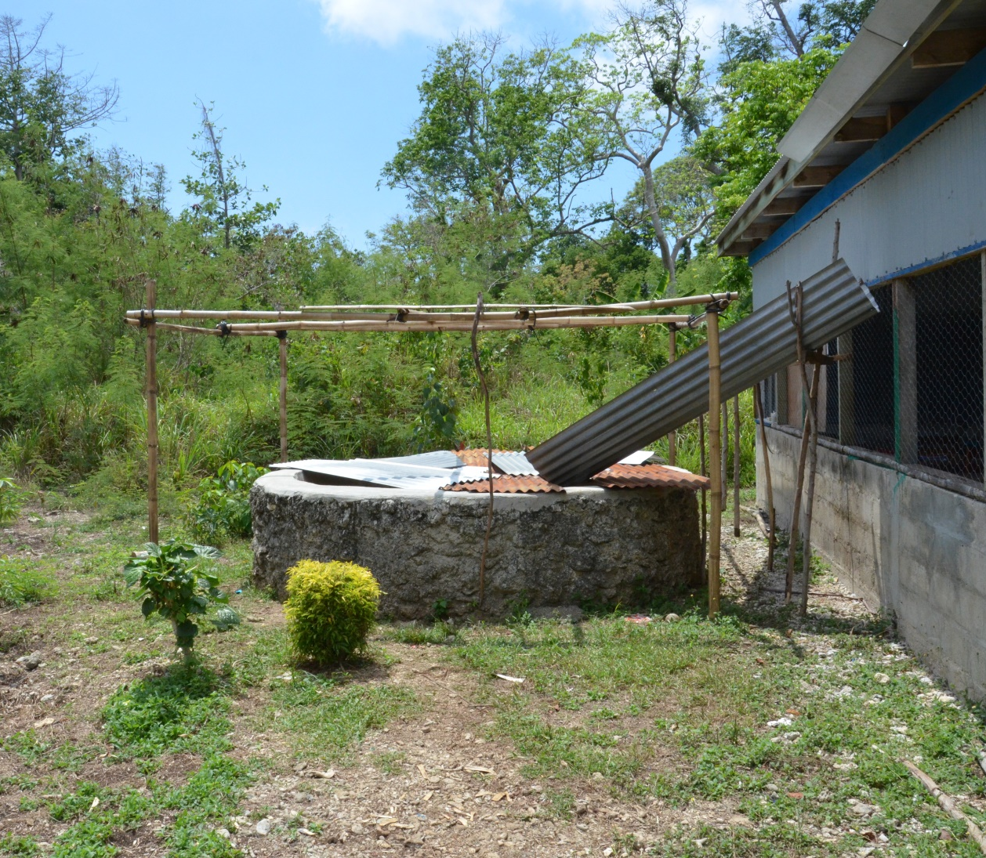
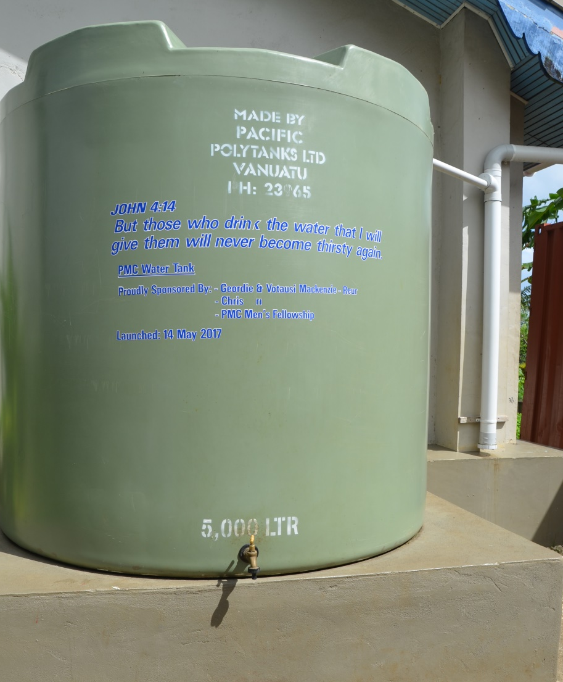
Healthcare
Village Water Well
Port Vila Water Tank

Slide 24
Religion
Church of Christ
Presbyterian Church
Roman Catholic Church

Slide 25
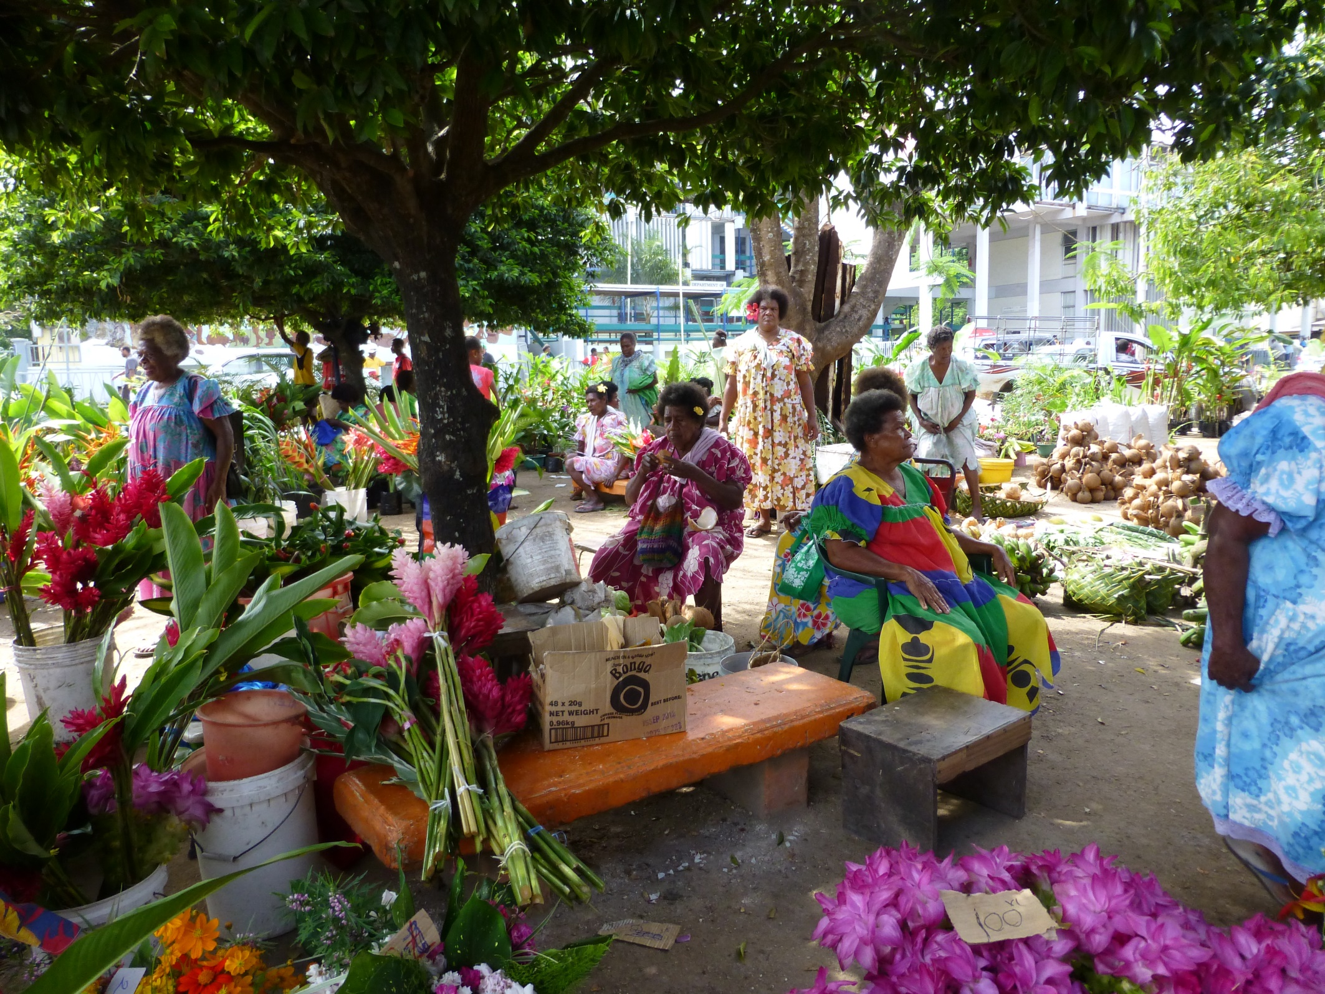
Women’s Rights

Slide 26
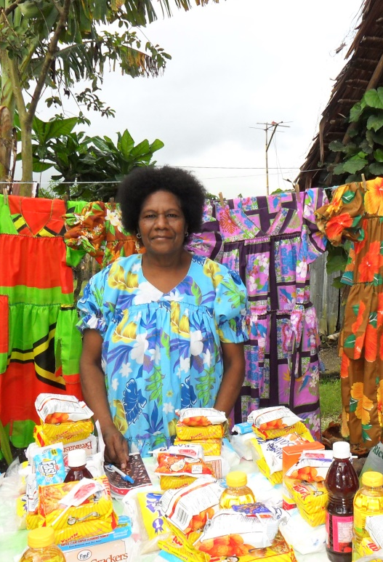
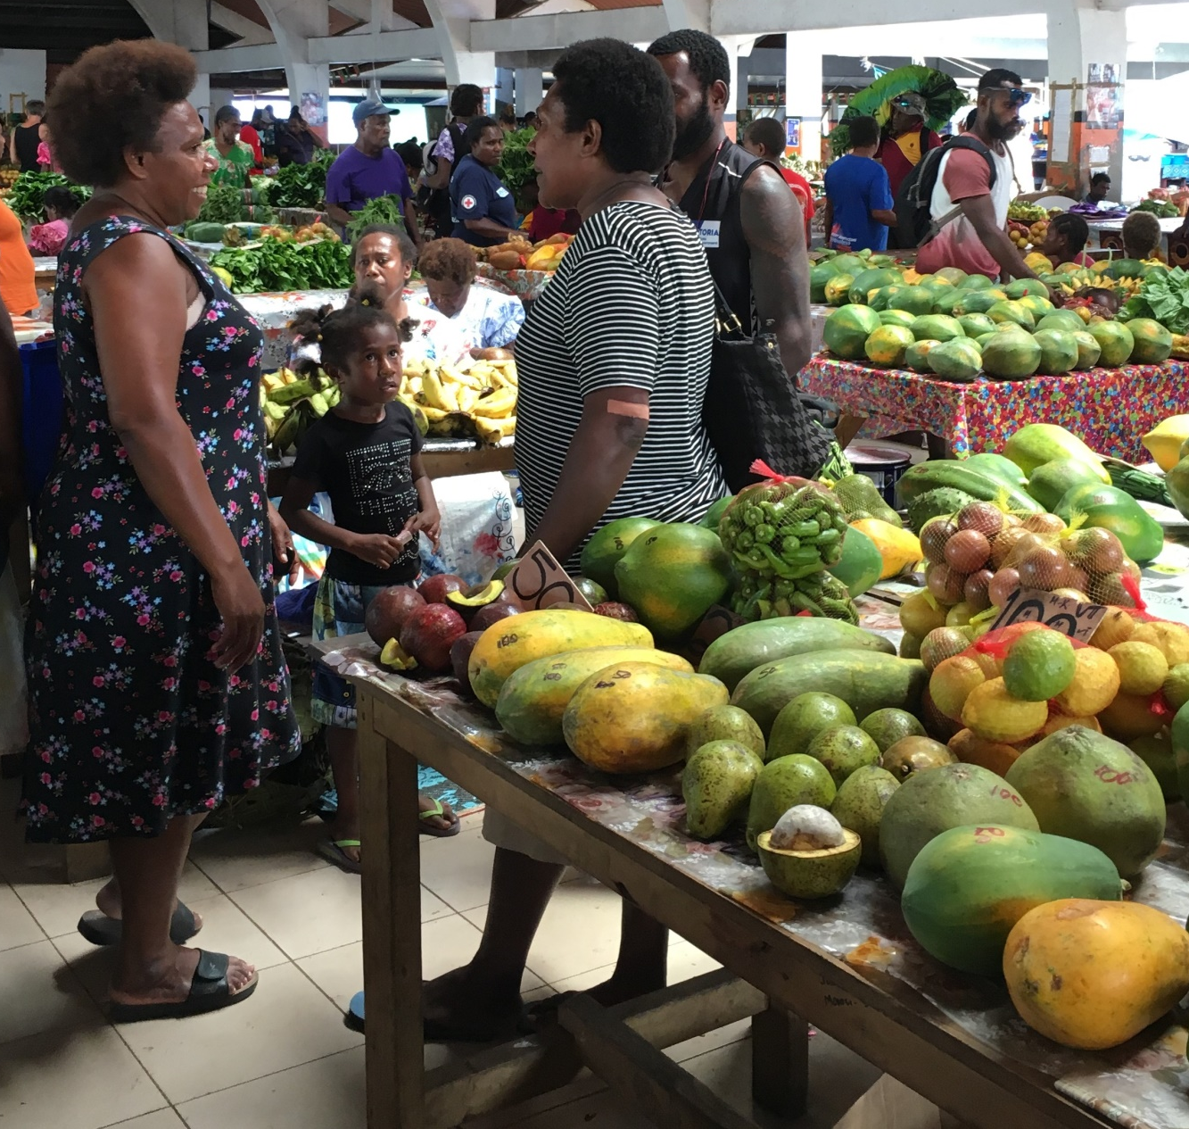
Women’s Rights

Slide 27
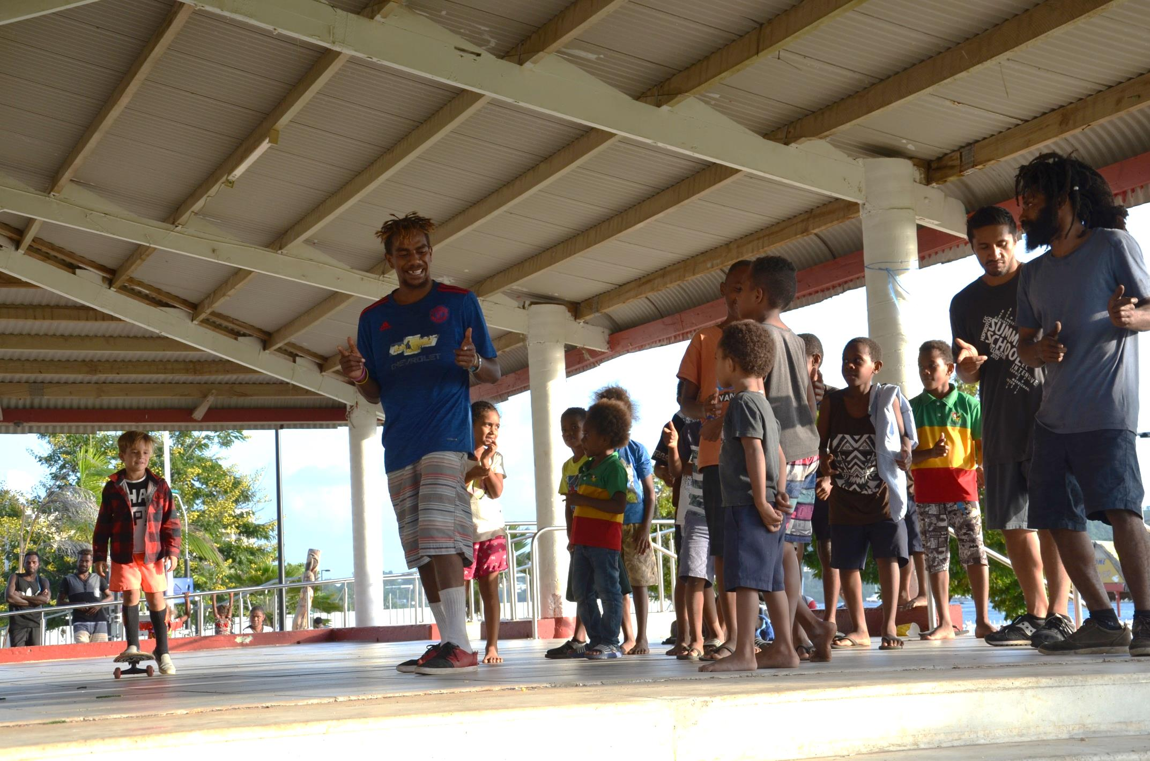
Youth

Slide 28
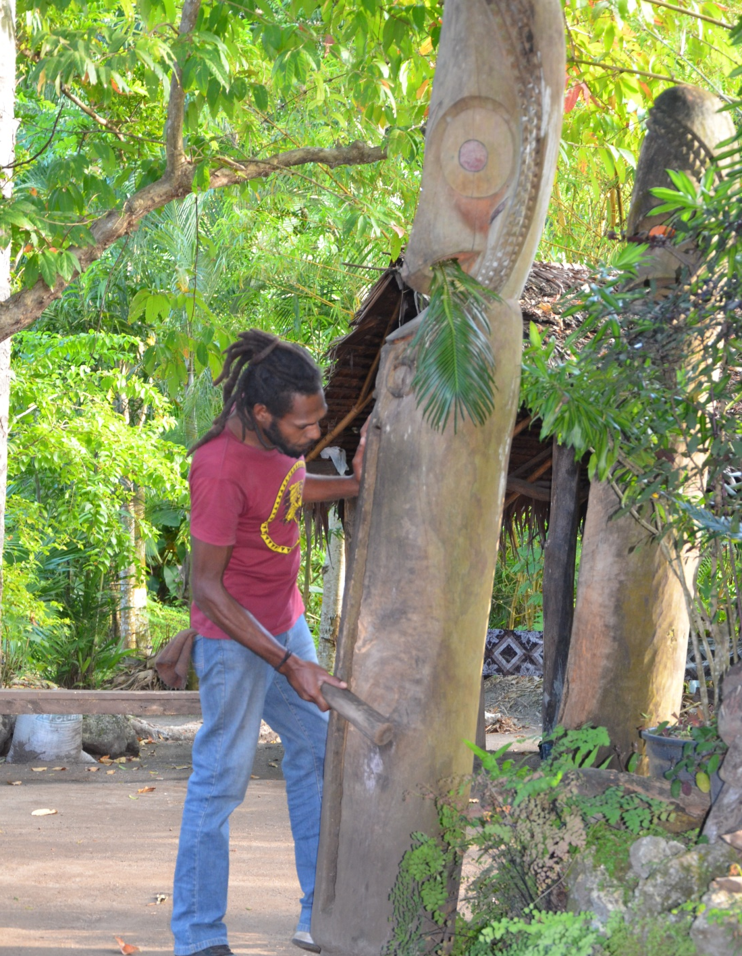
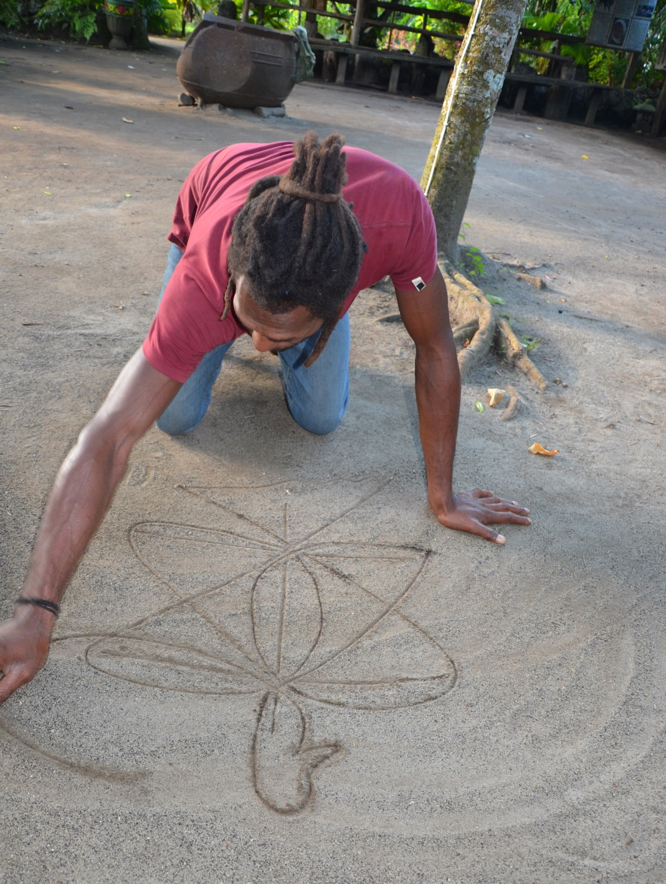
Culture
Slit Drum
Sand drawing

Slide 29
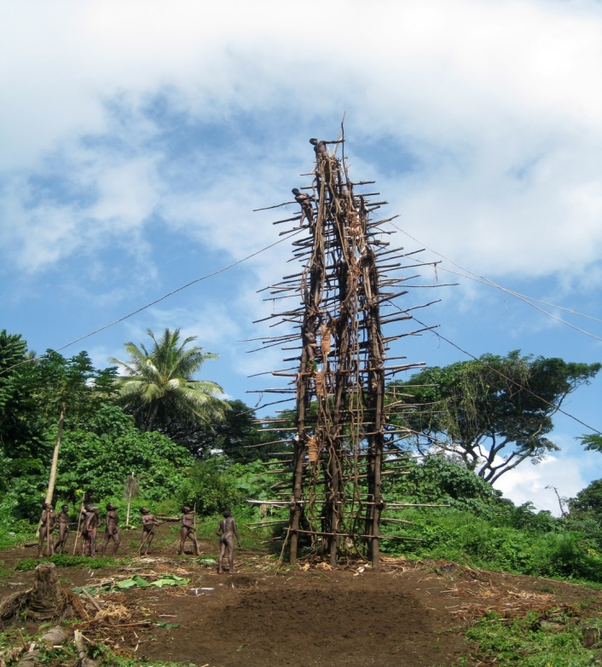
Culture
Nagol (land diving) Structure
©Roselyn Tor

Slide 30
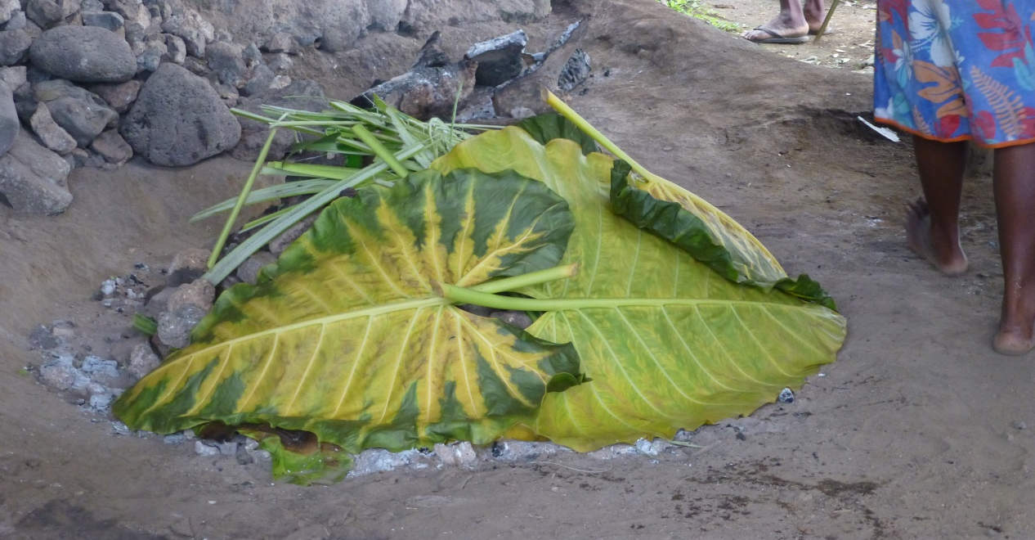
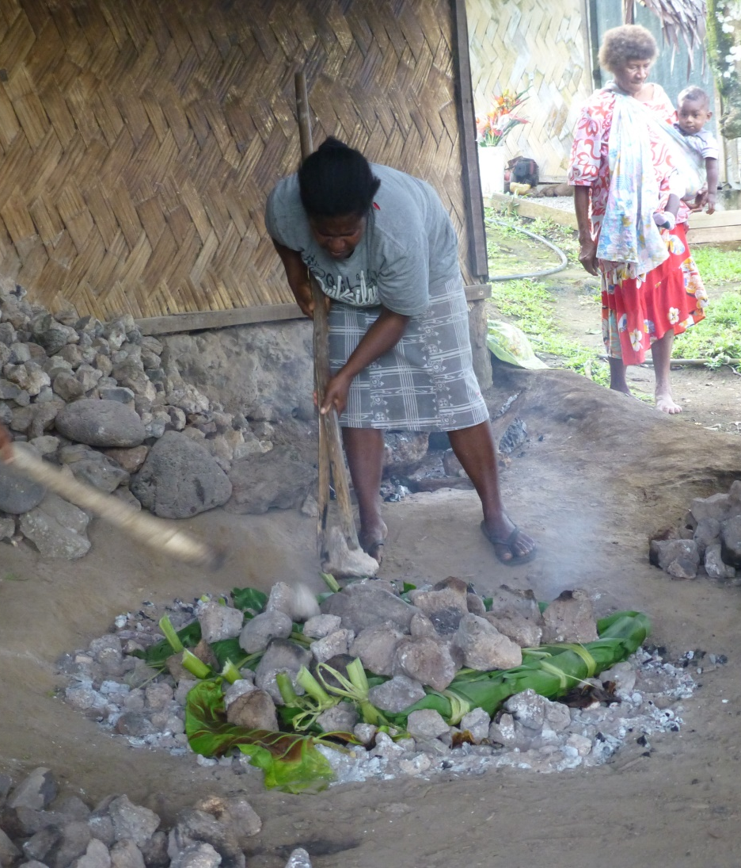
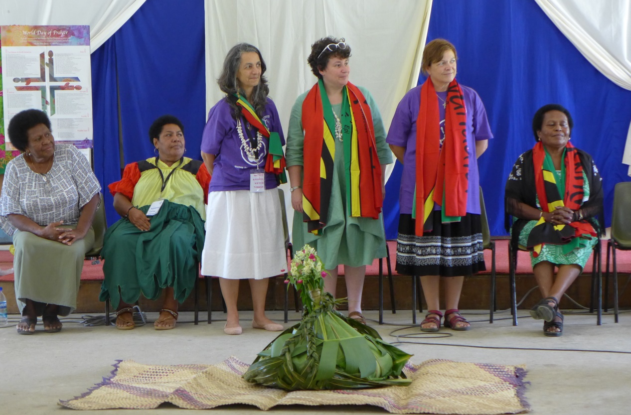
Culture
Cooking laplap and presenting it to WDP

Slide 31
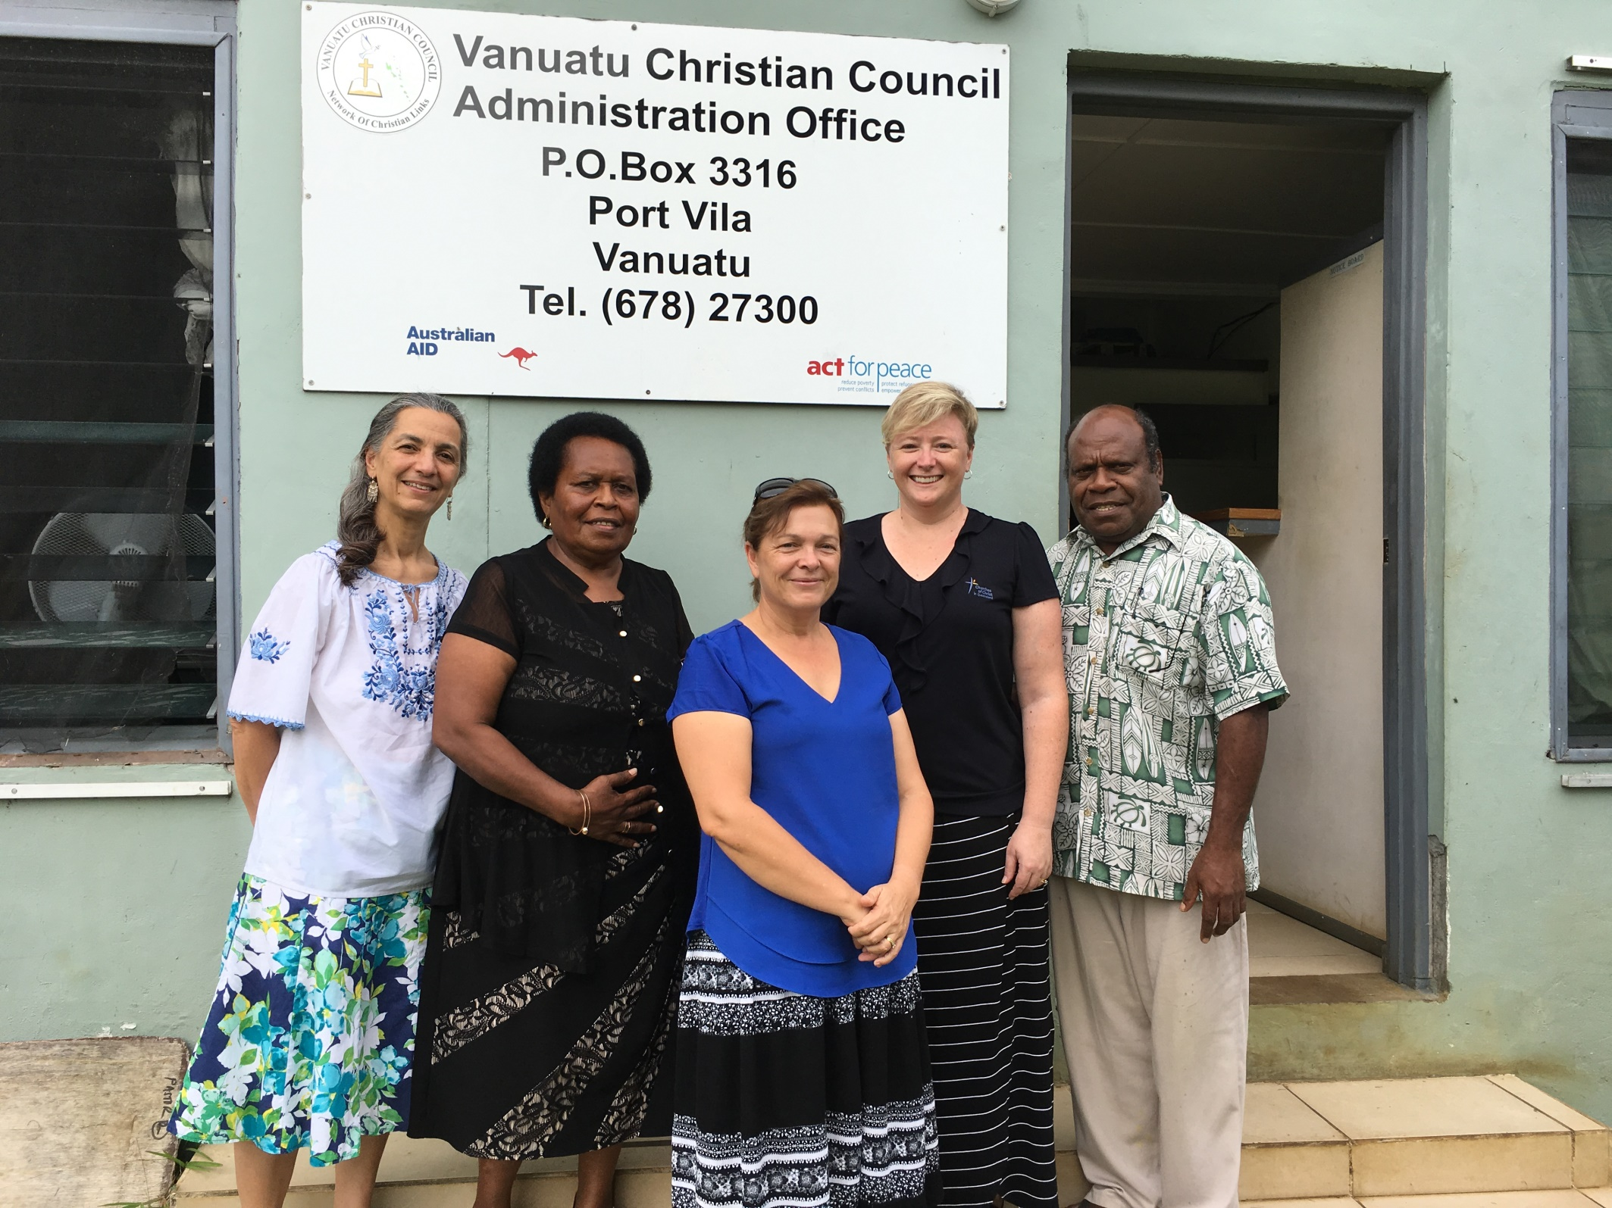
WDP History

Slide 32
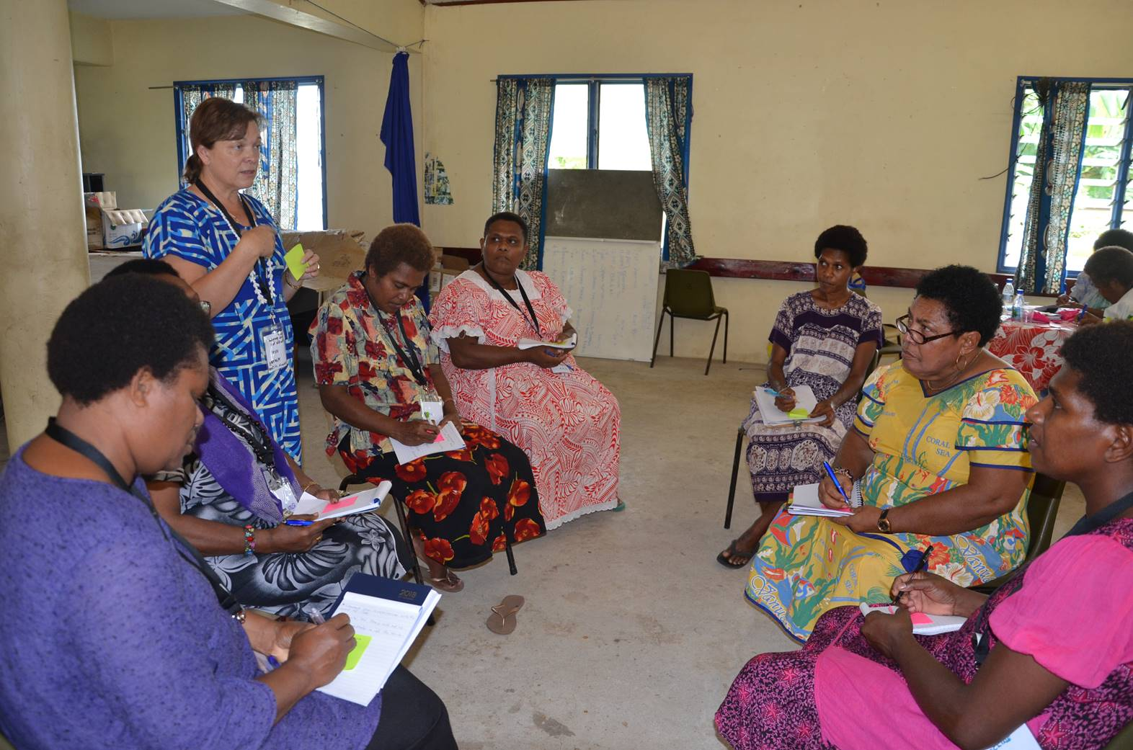
WDP History

Slide 33
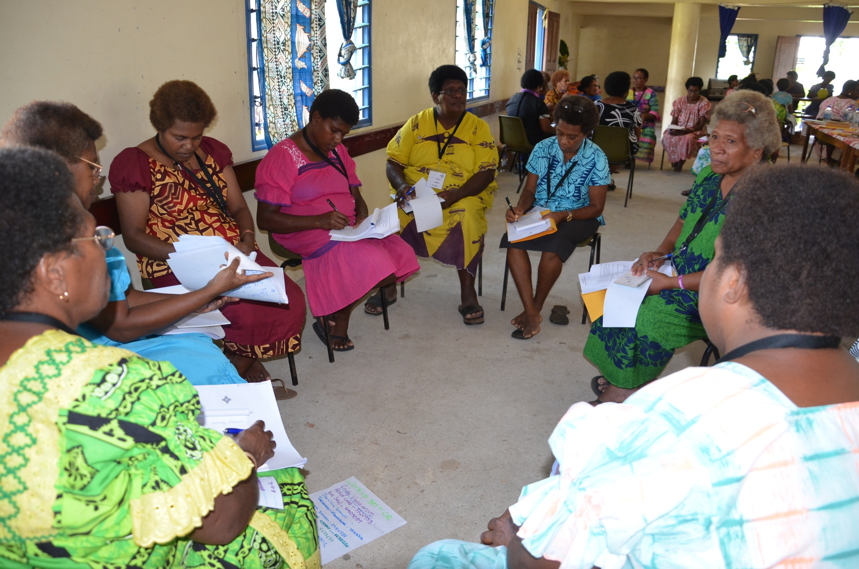
WDP History

Slide 34
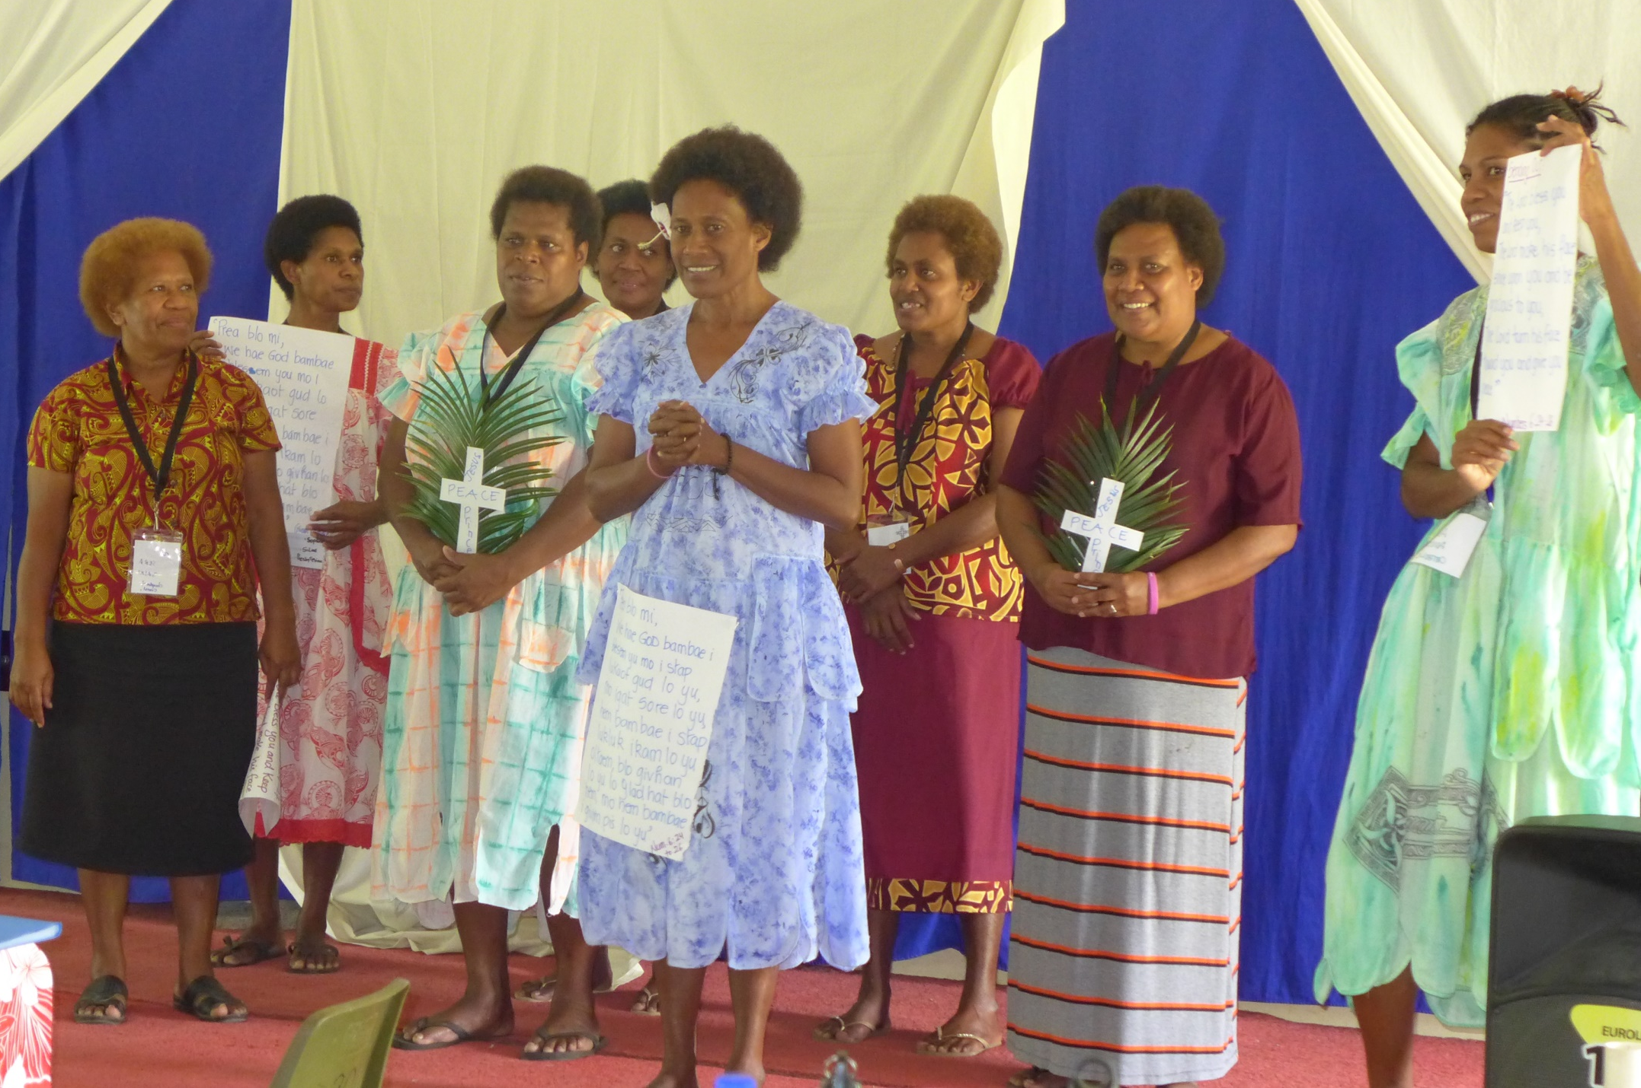
WDP History

Slide 35
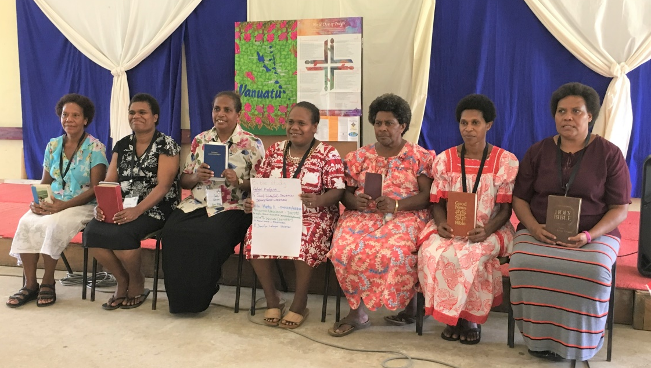
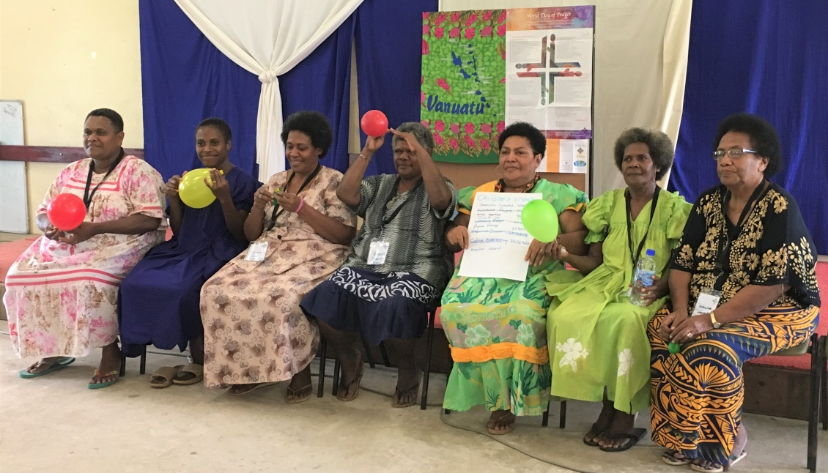
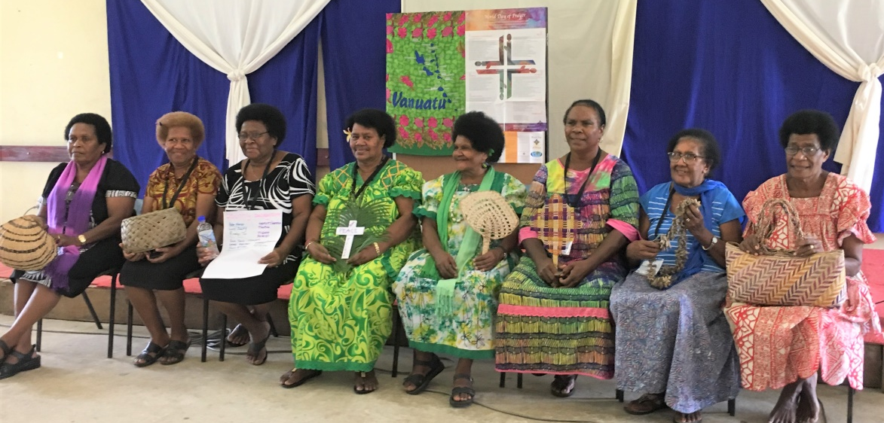
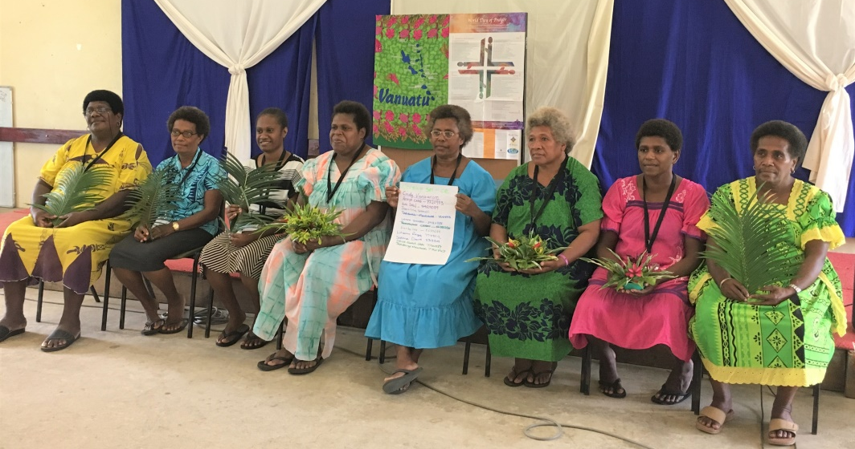
WDP History
Bible Study Group
Children’s Program Group
Country Background Group
Worship Service Group

Slide 36
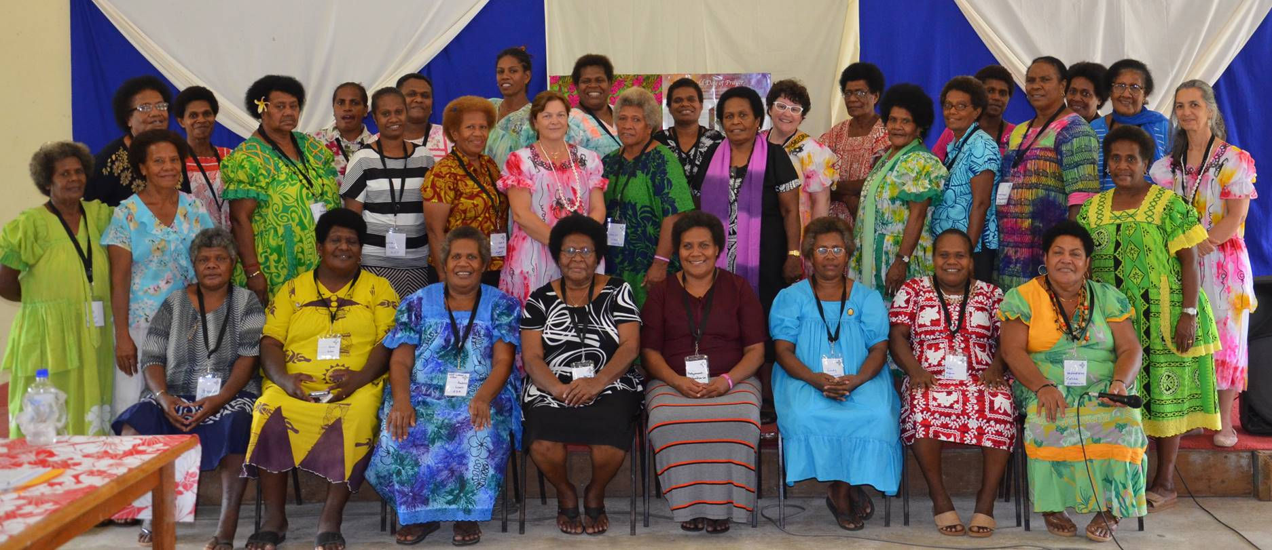
WDP History
WDP Vanuatu Committee

Slide 37
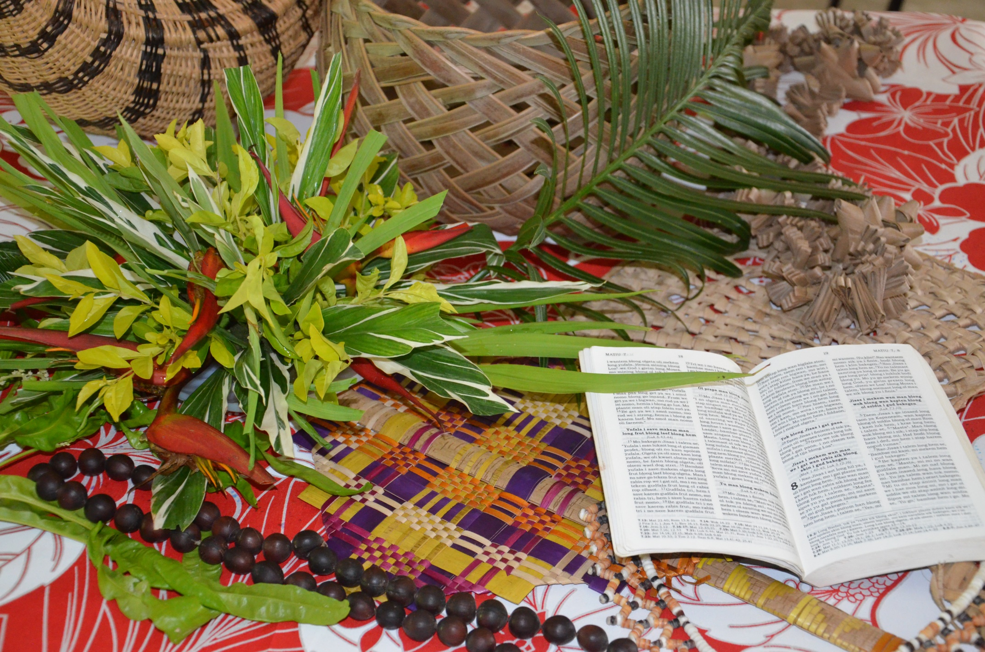
Illustration

Slide 38
Artist & Artwork
©Juliette Pita

